Slide 1
JMFS
2019-2020
Yearbook

Slide 2
Mrs. Martin
Dear John Muir Students and Parents,
This year has been another amazing year filled with hard work, fun experiences and laughter! Together we have created many memories that I hope will last a lifetime! Some of my favorite memories this year were the trunk or treat event where our Star Wars friends joined us, the color run and of course seeing so many students’ smiling faces as they walked out of the Eagles Nest with their chosen prizes. On behalf of our John Muir staff, I would like to wish our 5th grade promoting students a successful future as you move on to your new intermediate school. You will be missed greatly, but we are confident you will do well as your future is very bright! Our hope is that you shoot for the moon and never forget we believe in you! This is not goodbye, but we will miss you until we meet again….

Slide 3
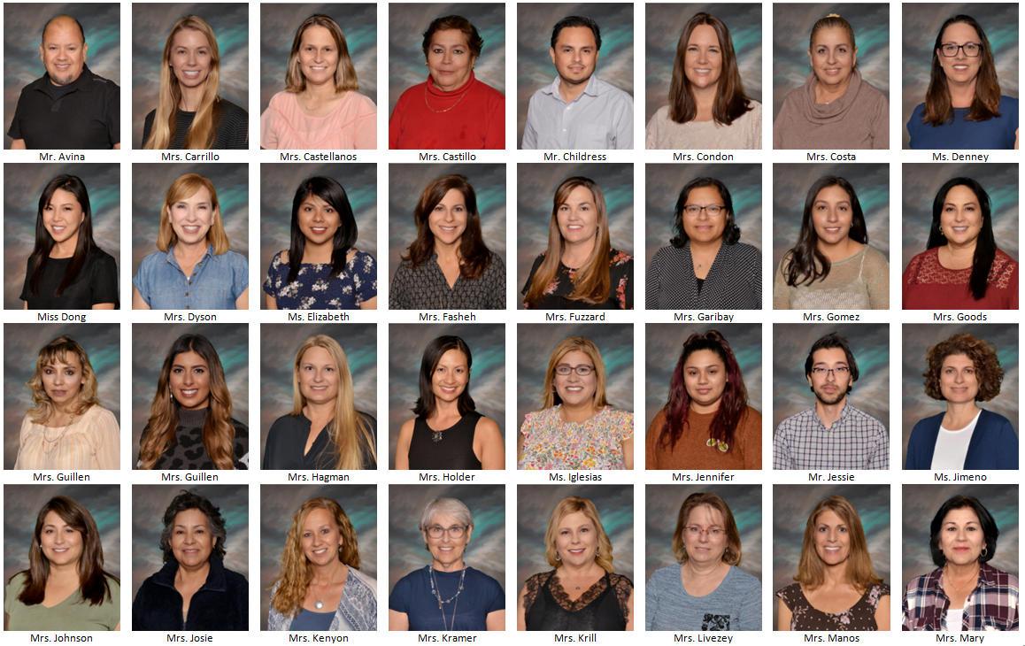
Staff

Slide 4
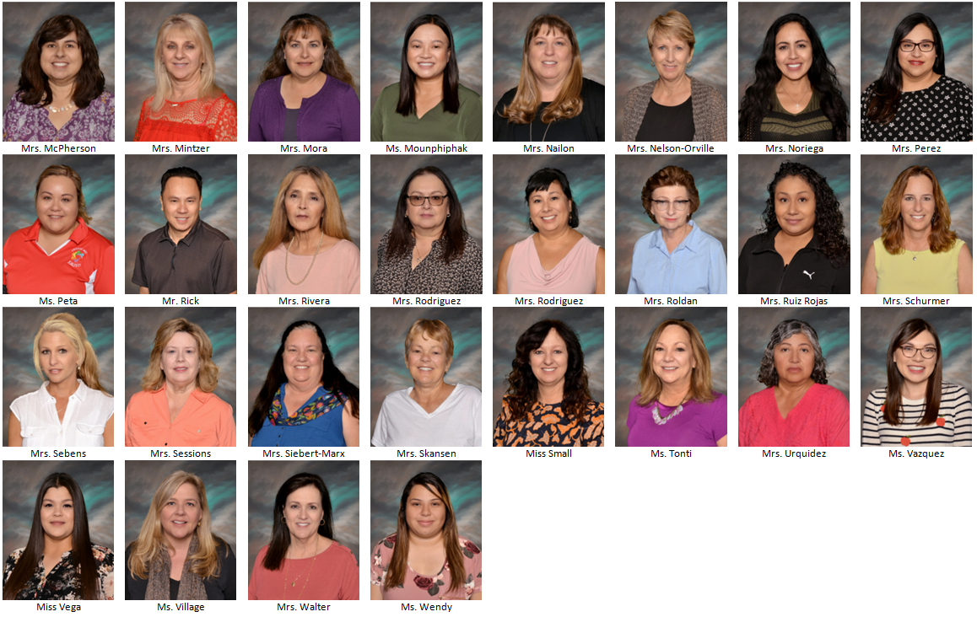

Slide 5
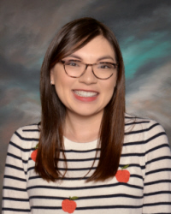
Ms. Vazquez Kinder – 5th Grade

Slide 6
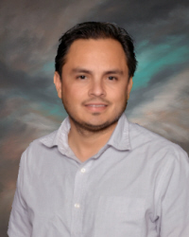
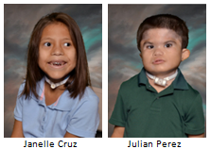
Mr. Childress 2nd - 5th Grade

Slide 7
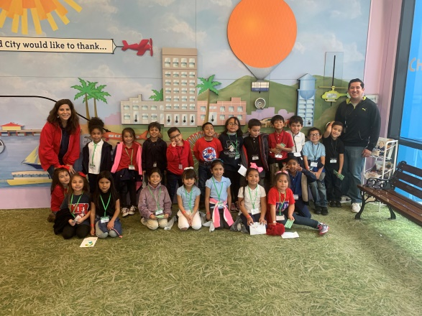
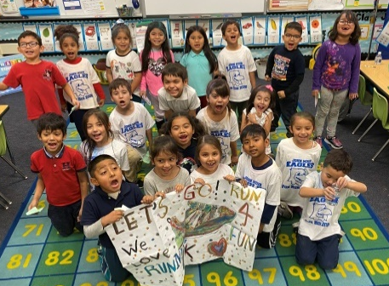
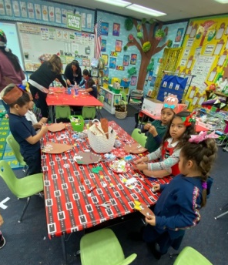
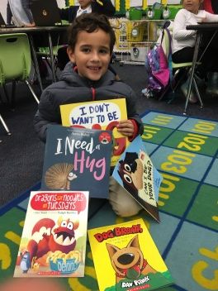
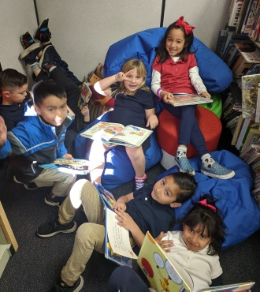
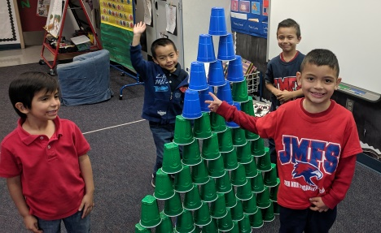
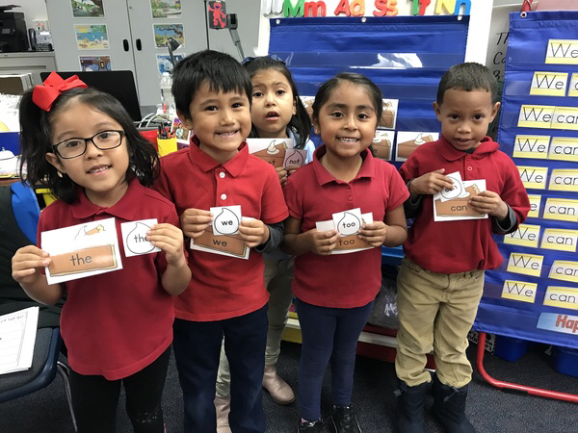
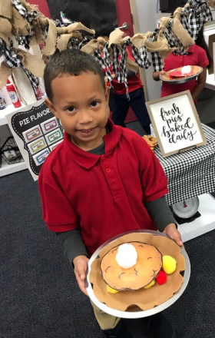
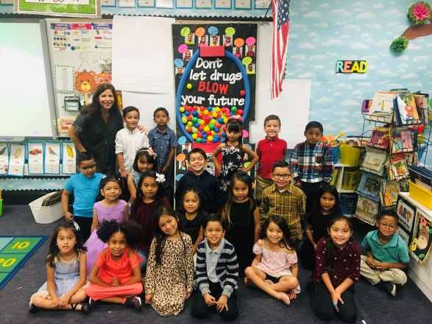
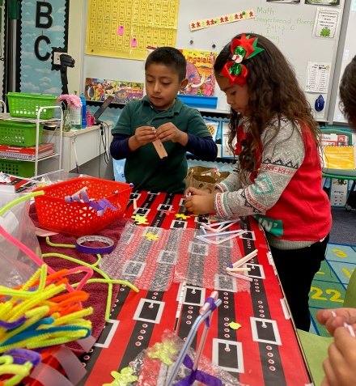
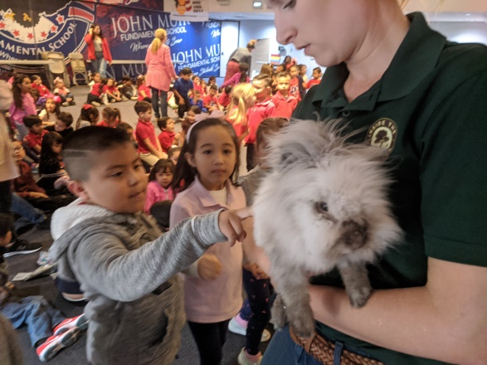
Kindergarten

Slide 8
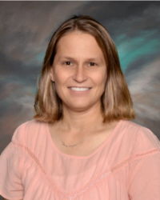
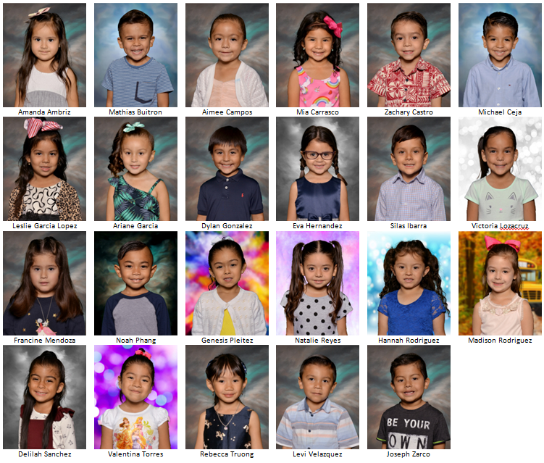
Mrs. Castellanos Transitional Kindergarten

Slide 9
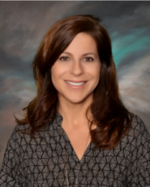
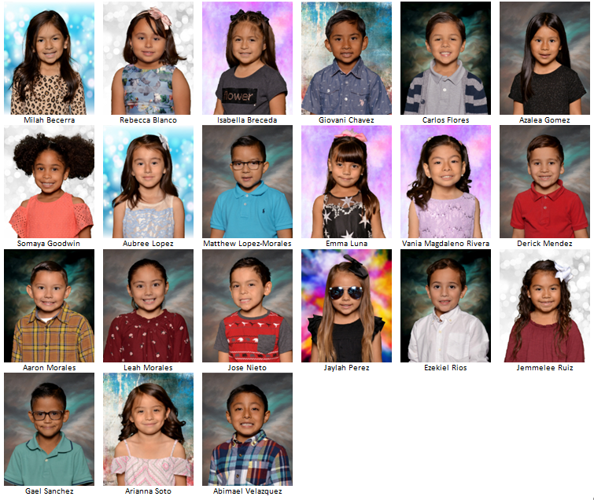
Mrs. Fasheh Kindergarten

Slide 10
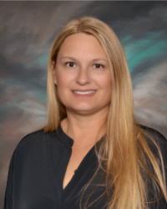
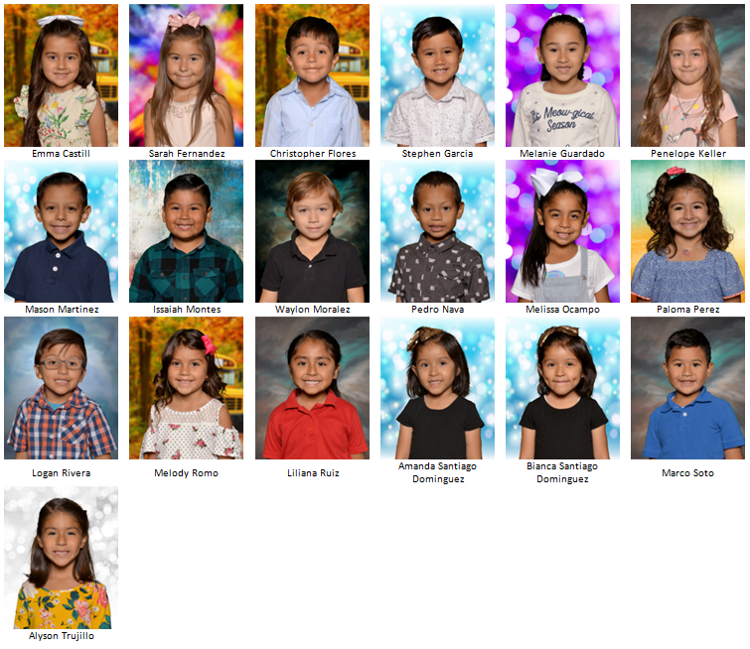
Mrs. Hagmann Kindergarten

Slide 11
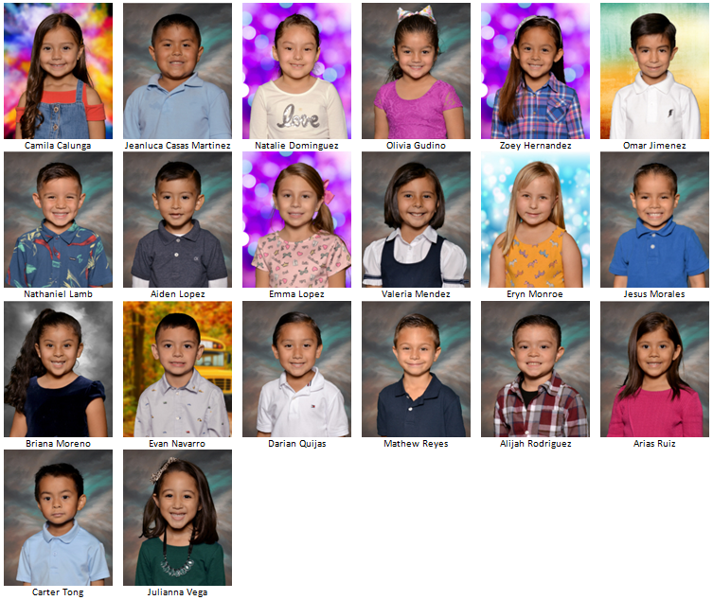
Mrs. Johnston Kindergarten

Slide 12
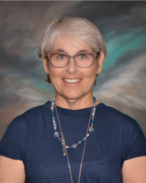
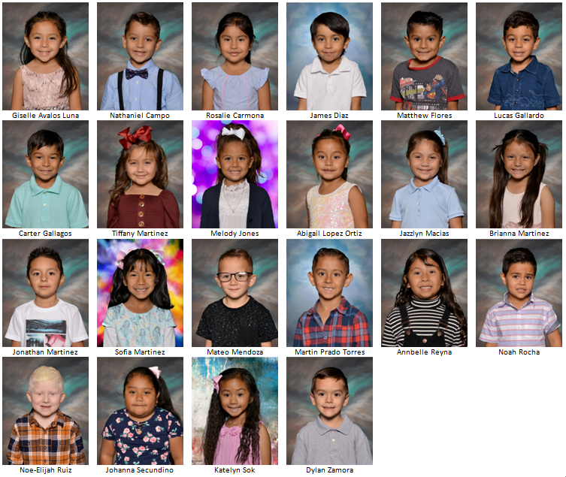
Mrs. Kramer Kindergarten

Slide 13
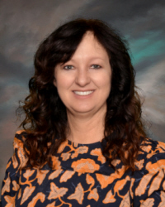
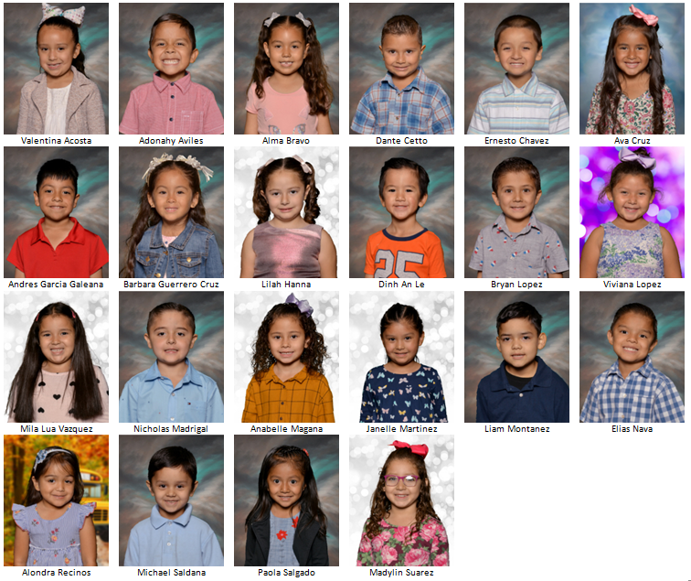
Miss Small Kindergarten

Slide 14
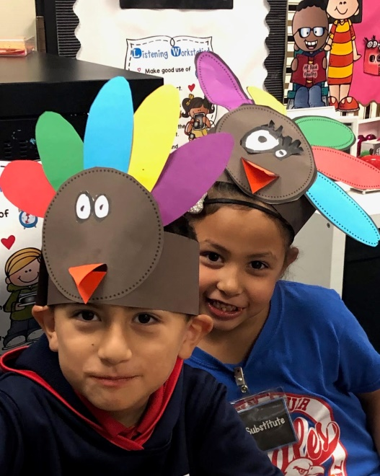
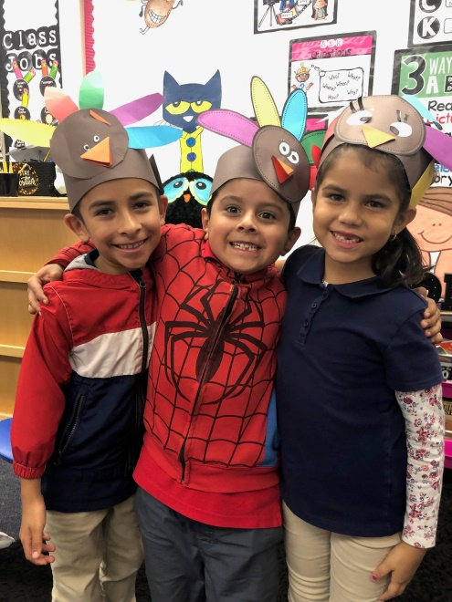
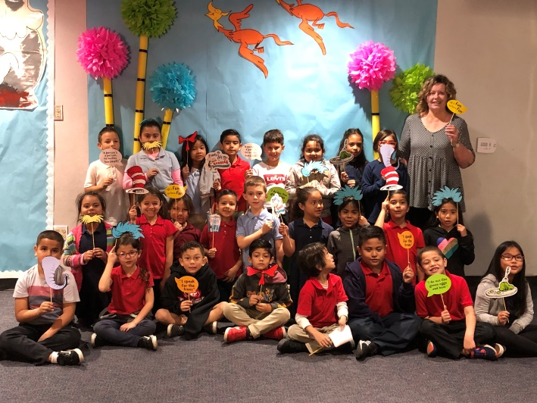
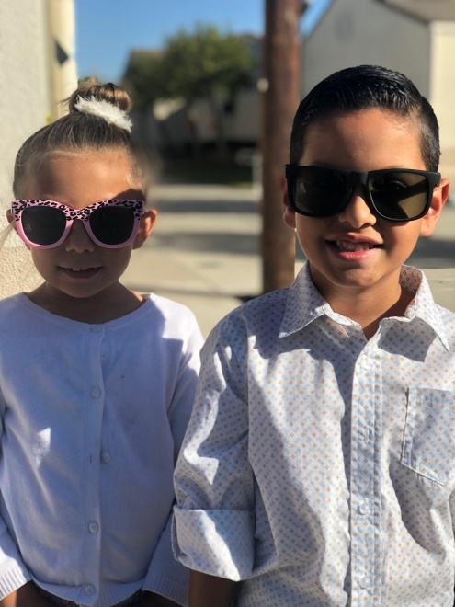
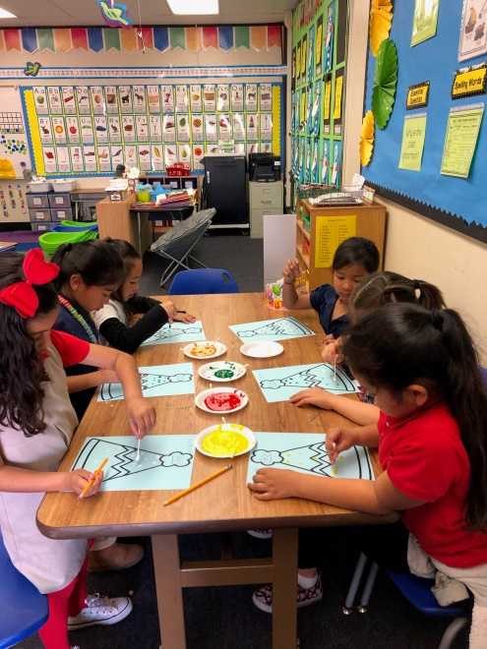
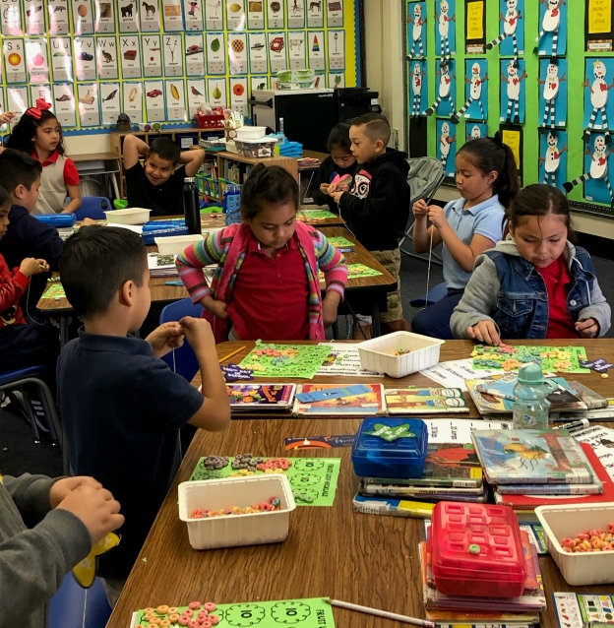
First Grade

Slide 15
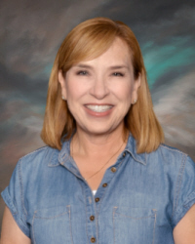
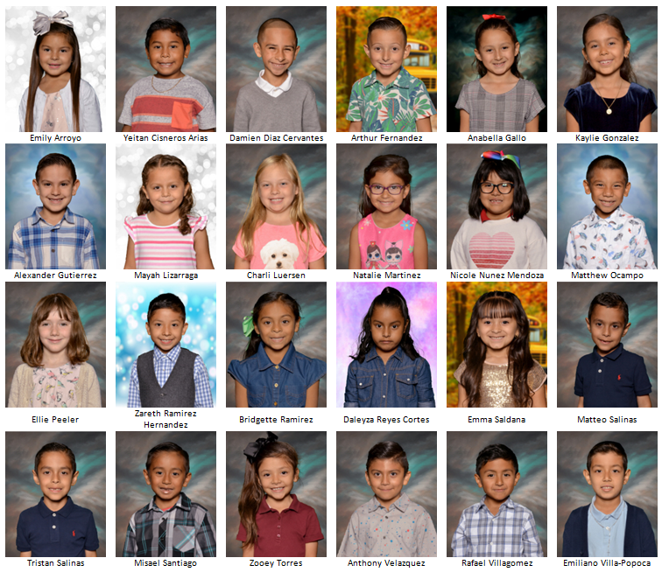
Mrs. Dyson 1st Grade

Slide 16
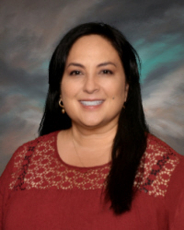
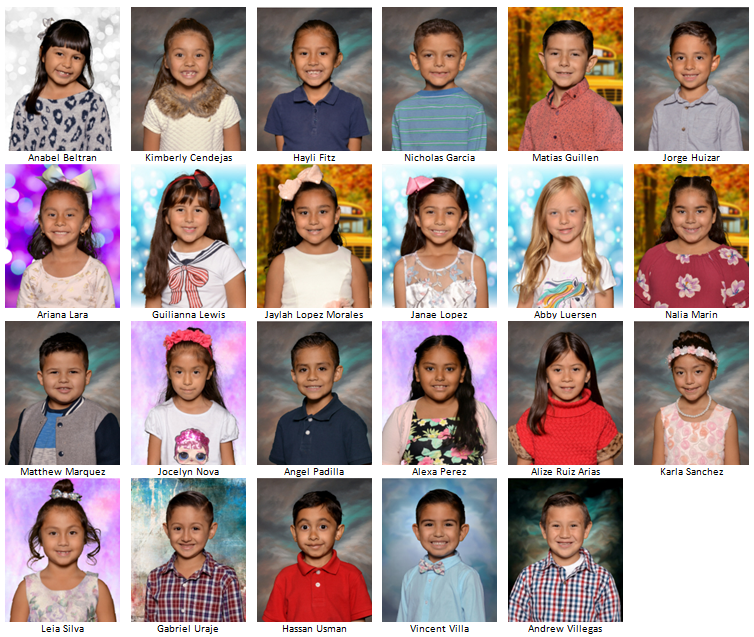
Mrs. Goods 1st Grade

Slide 17
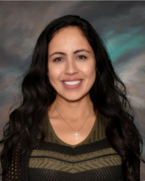
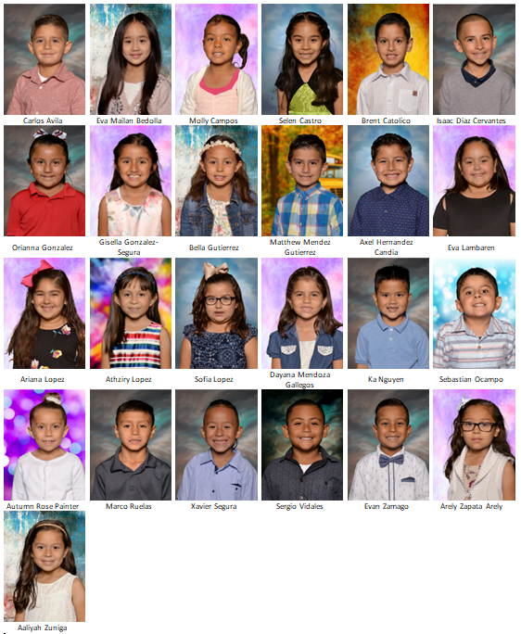
Mrs. Noriega 1st Grade

Slide 18
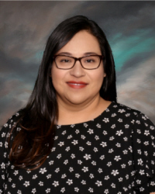
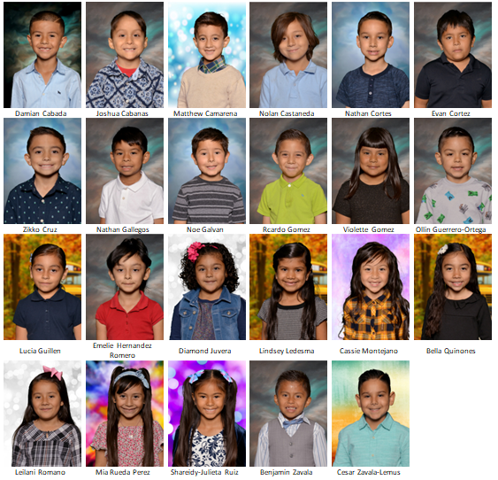
Mrs. Perez 1st Grade

Slide 19
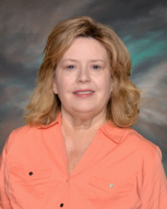
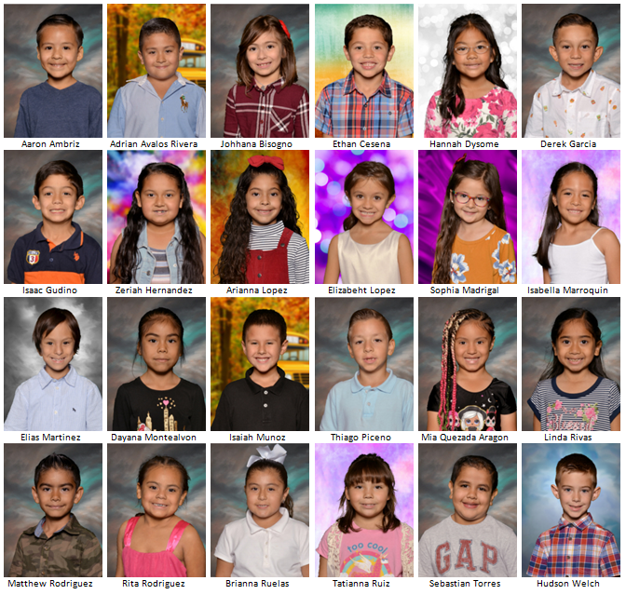
Ms. Sessions 1st Grade

Slide 20
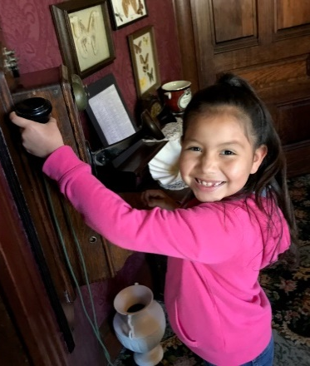
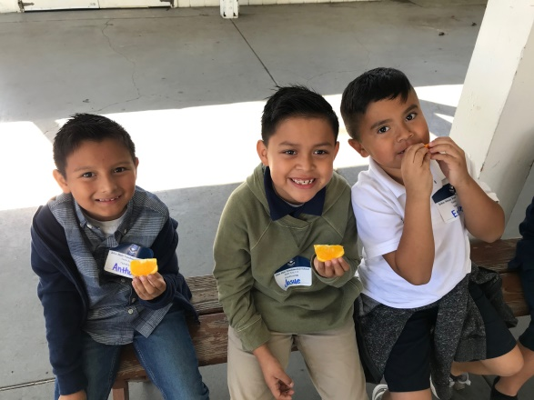
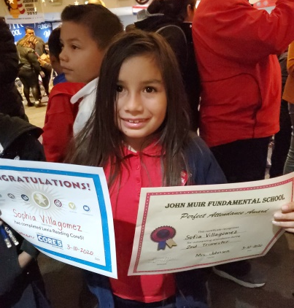
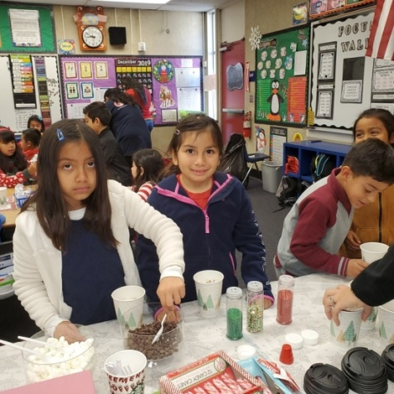
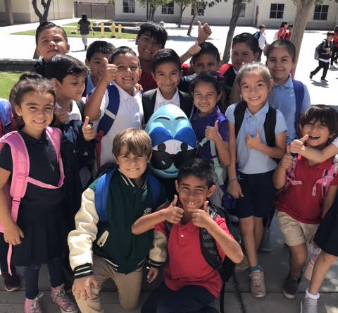
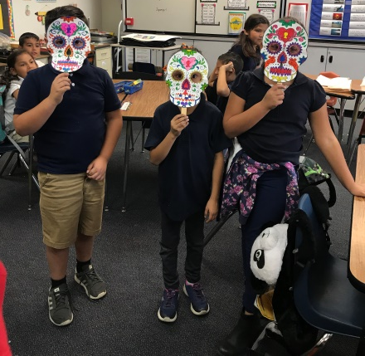
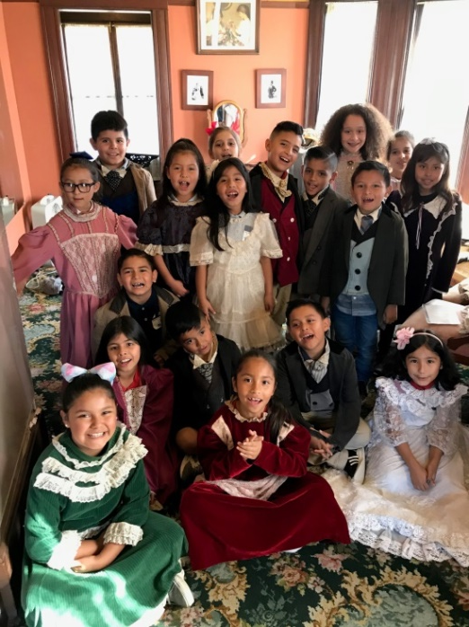
Second Grade

Slide 21
Fuzzard 2nd Grade

Slide 22
Mrs. Johnson 2nd Grade

Slide 23
Mrs. Nailon 2nd Grade

Slide 24
Mrs. Nelson-Orville 2nd Grade

Slide 25
Mrs. Rowen 2nd Grade

Slide 26
Third Grade

Slide 27
Mrs. Condon 3rd Grade

Slide 28
Mrs. Krill 3rd Grade

Slide 29
Mrs. Siebert-Marx 3rd Grade

Slide 30
Mrs. Walter 3rd Grade

Slide 31
Fourth Grade

Slide 32
Mrs. Holder 4th Grade

Slide 33
Mrs. Jimeno & Ms. Simon 4th Grade

Slide 34
Mrs. McPherson 4th Grade

Slide 35
Ms. Rodriguez 4th Grade

Slide 36
Ms. Village 4th Grade

Slide 37
Fifth Grade

Slide 38
Mrs. Manos 5th Grade

Slide 39
Ms. Mora 5th Grade

Slide 40
Ms. Mounphiphak 5th Grade

Slide 41
Mrs. Schurmer 5th Grade

Slide 42
Mrs. Tonti 5th Grade

Slide 43
5th Grade Camp

Slide 46
5th Grade Dedications

Slide 47
Aurora Lira
Aurora,
We are so very proud of you! Your enthusiasm for life and love for music, art and animals is inspiring! We love you so very much and can’t wait to see how you blossom in middle school.
Love,
Mom, Dad,
Joseph, and Aaron

Slide 48
Damien Braun
You always keep moving forward and have accomplished so many things. I am so proud of you!! Keep pushing my Brown Mamba!!

Slide 49
Eleny Morales
Always go the extra mile!

Slide 50
Isabella Camper
Isabella,
Your Daddy and I have watched in amazement as you’ve grown into the young person you are today and we’re watching with great anticipation to see what you become. With your talent and determination the sky’s the limit, Isabella we love you so very much.

Slide 51
Joel Hyman
Congratulations Joel!
We are so proud of you and the young man you’re growing into. Remember the ways of the world will be changing but never forget your faith and who you are and you will continue to be blessed.
Love you son,
Your Mom and Dad

Slide 52
Joseph Macias

Slide 53
Marcus Poserio
Dear Marcus,
Congratulations!!!
We are so proud of you and your accomplishments.
We’re confident that you will continue with even more success. We’re always here to support you. Good luck in middle school!
We love you!!!
Love,
Mommy & Daddy

Slide 54
Olive Lopes
We are proud of you, Olive Jane!
We hope you continue to be as happy, joyful, and kind as you are today! You are such a bright light in this world.
Love,
Mommy, Daddy & Luca

Slide 55
Distance Learning

Slide 59
Revolution Day

Slide 60
Trunk-or-Treat

Slide 61
FIBO Art

Slide 62
Veteran’s Day

Slide 63
Ground Breaking Ceremony

Slide 64
Color Run

Slide 66
Family Fun Nights

Slide 68
Read Across America

Slide 69
Restaurant Nights

Slide 70
Ice Cream Social

Slide 71
Skate Nights

Slide 72
PFO

