Slide 1
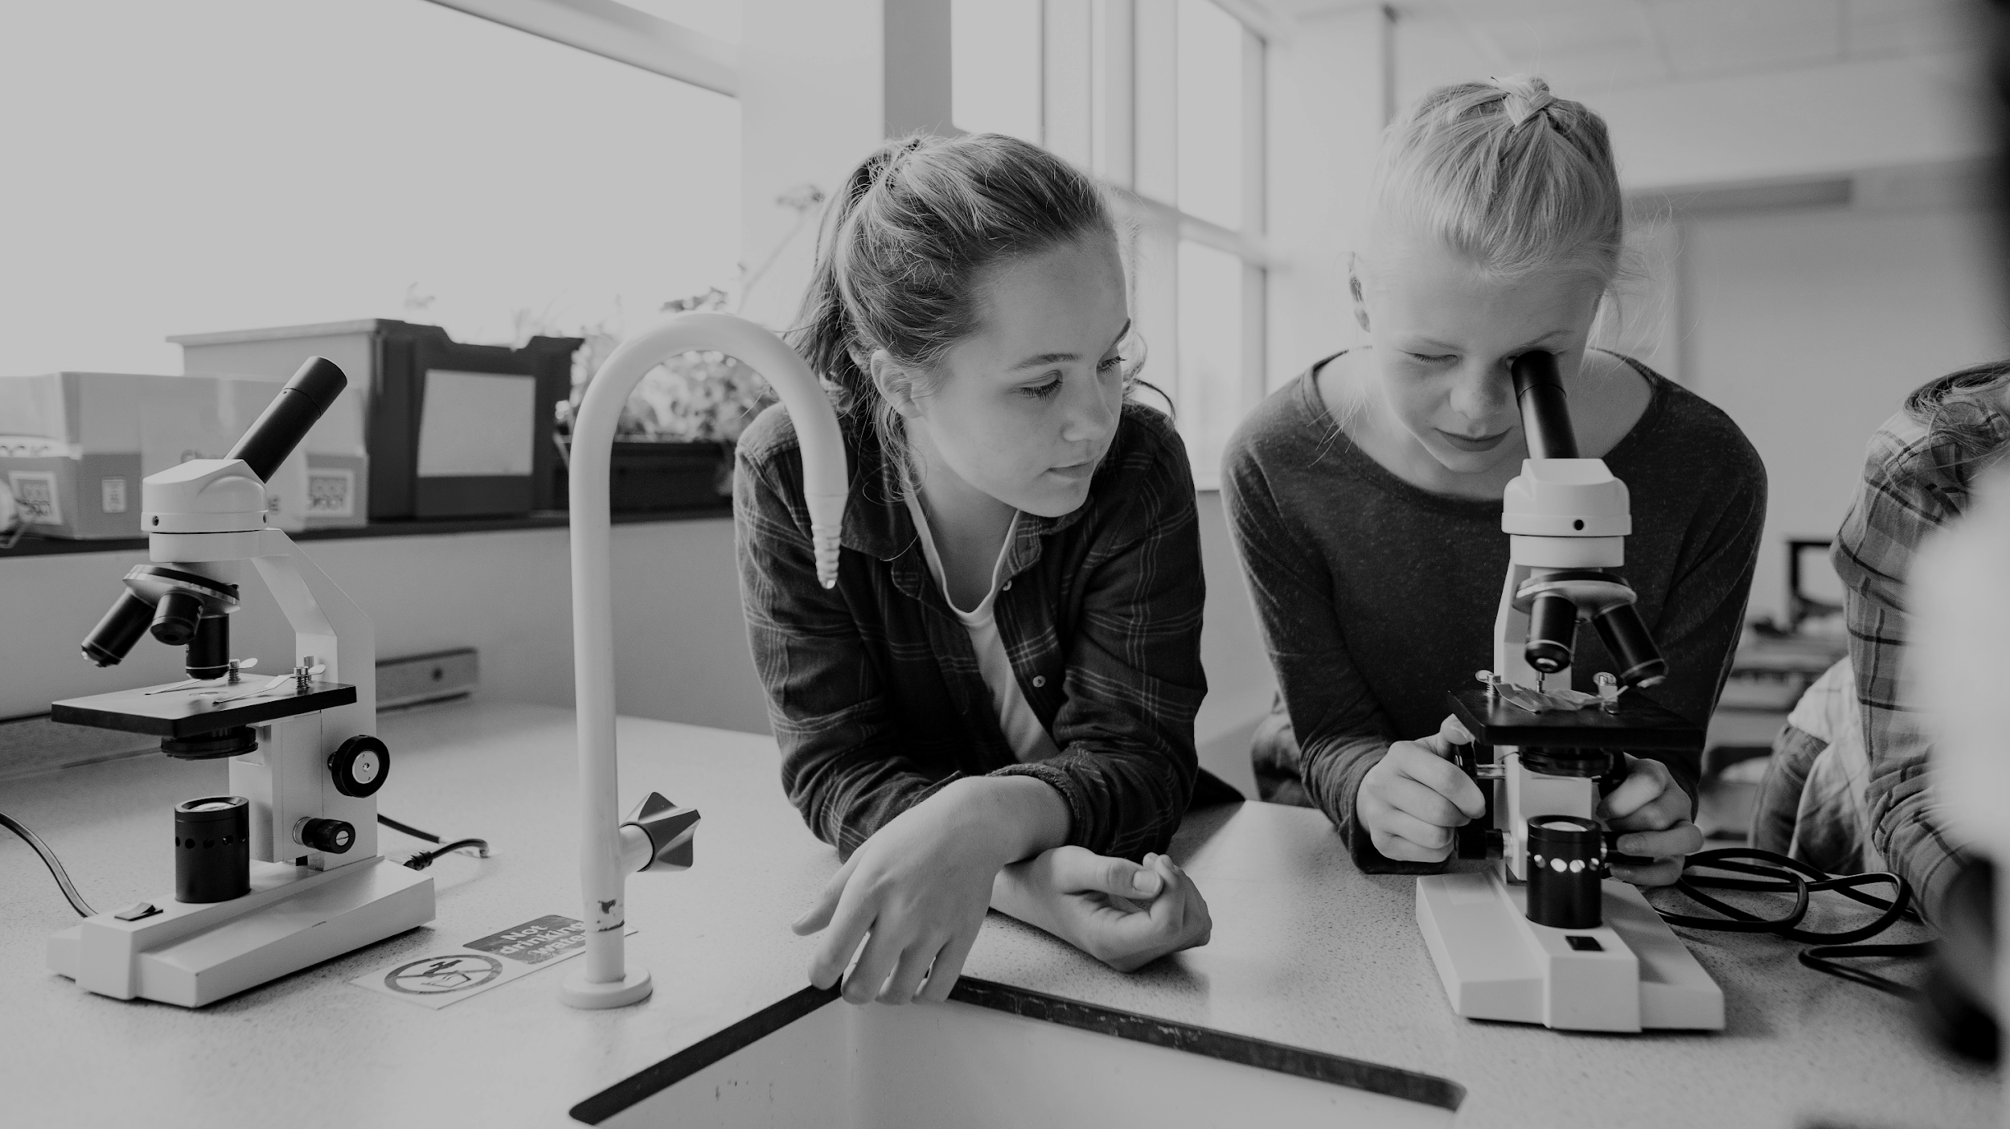
2024-2025 ADVANCED LEARNING ACADEMY ADVISORY BOARD MEETING December 18, 2024
Presentation by:
Amy Scruton
Principal

Slide 2
HISTORY
 | 2020-2021* | 2021-2022 | 2022-2023** | 2023-2024 | 2024-2025 ***
Grades | 3rd-12th | 3rd-12th | K-12th | TK-12 | TK - 12
Elementary | 51 | 36 | 59 | 87 | 106
Intermediate | 179 | 173 | 117 | 112 | 108
High School | 114 | 179 | 152 | 157 | 140
Total Enrollment | 344 | 388 | 328 | 356 | 354
Teachers | 21 | 23 | 25 | 25 | 28
Location | 1st Street (9-12) 4th Street (3-8) Circulos Grant-4 | Hoover (3-8) Walker (9-12) Circulos Grant-5 | Santa Clara (K-8) Bishop (9-12) | Santa Clara (TK-8) Bishop (9-12) | Santa Clara (TK-8) Bishop (9-12)
* * Distance Learning
** Addition of K, 1, and 2
*** Addition of elementary staff

Slide 3
Current Advisory Board Officers
Diana Torres- Board President
Alicia Skibby- Vice President
Gloria Lira- Member
Cheryl Whittington- Member
Bryan Davis- Member

Slide 4
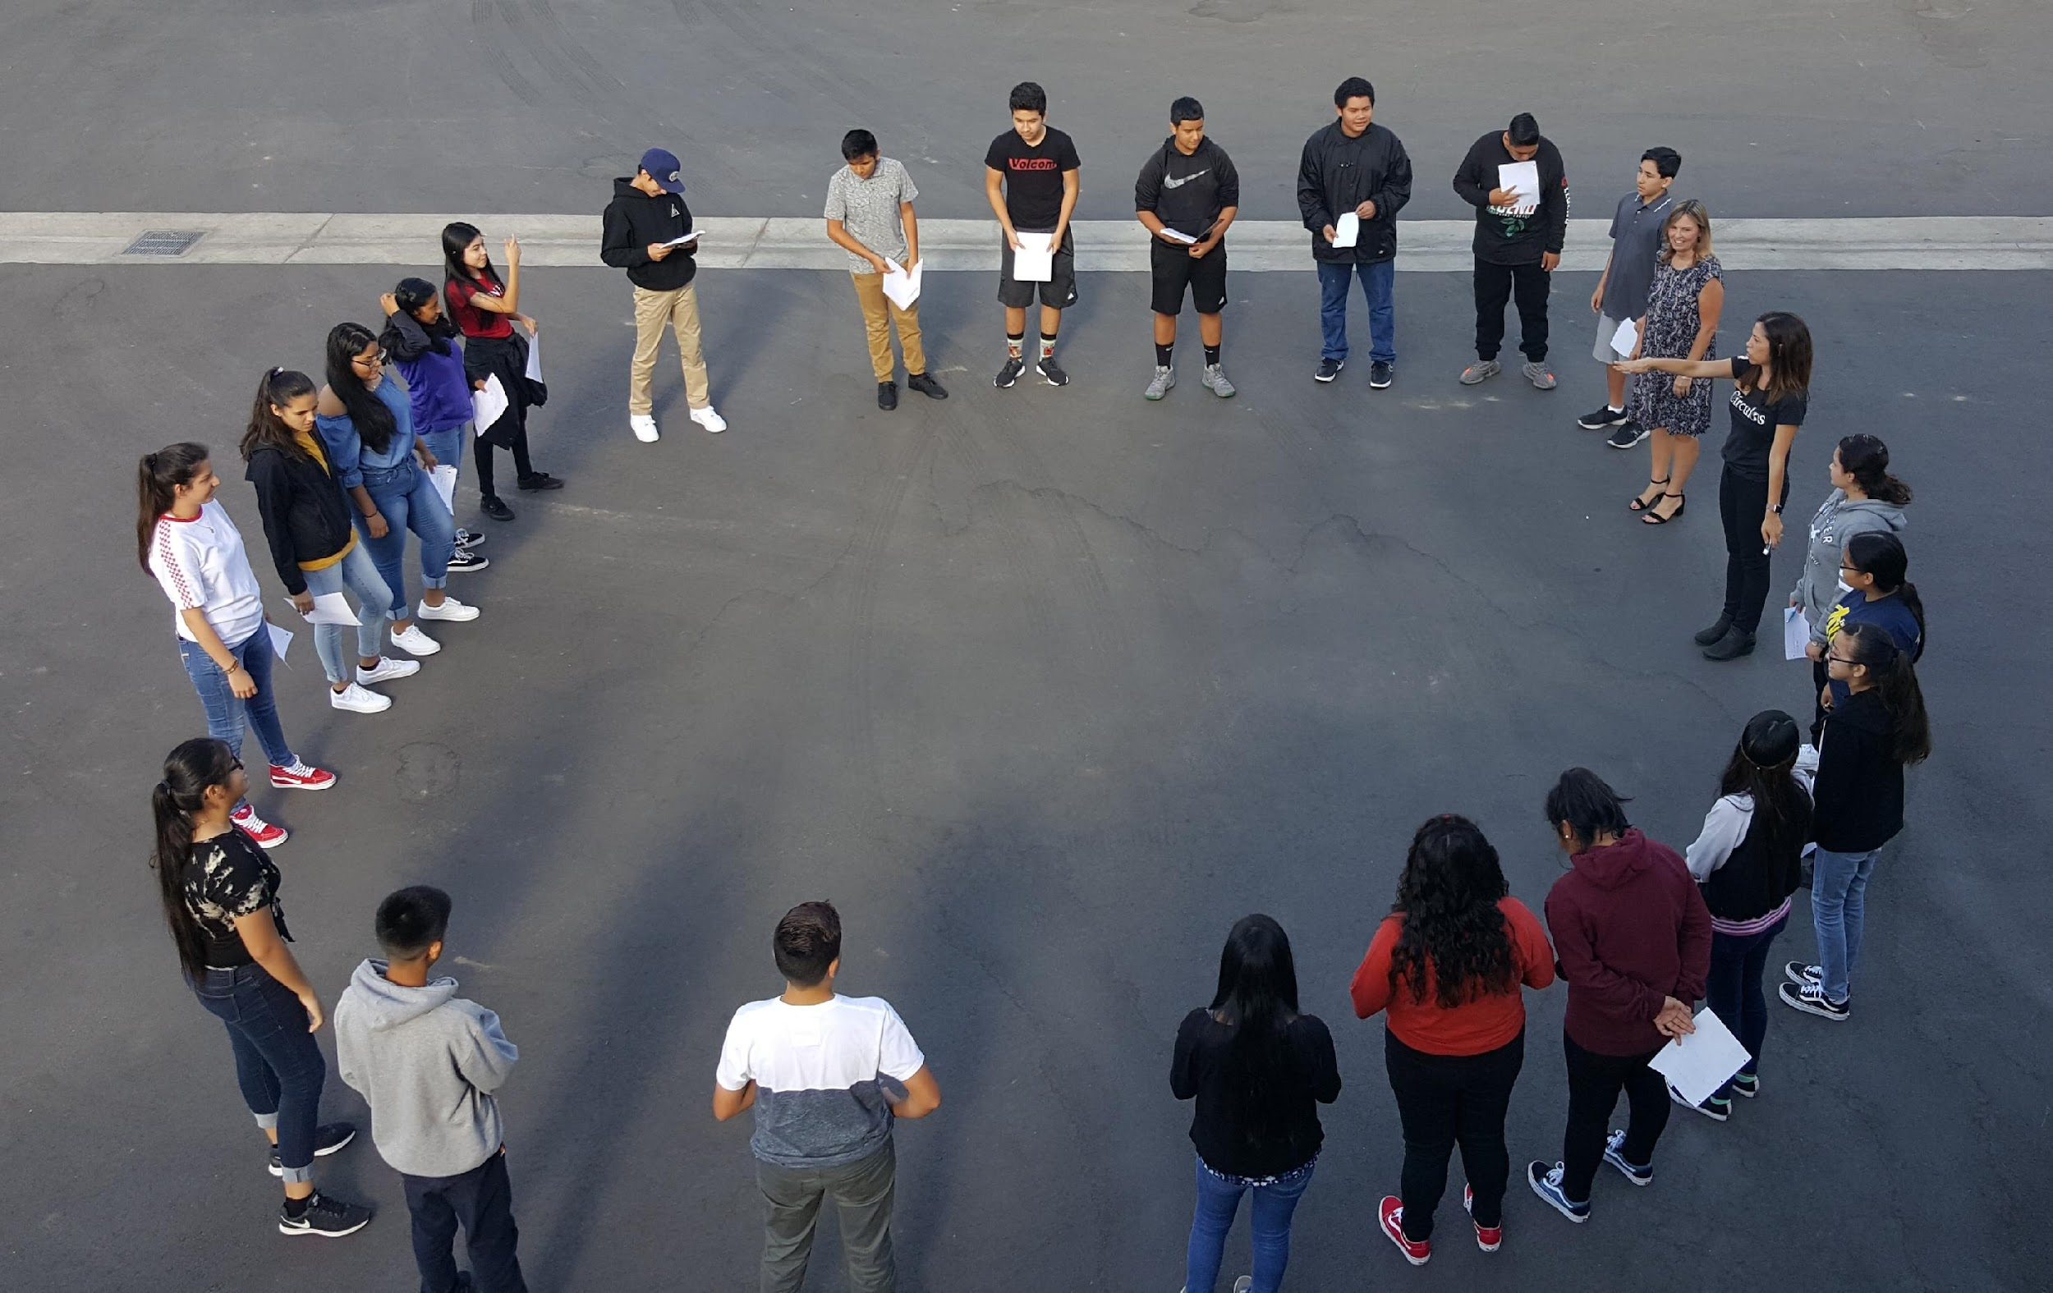
REVENUES:
LCFF Sources
Federal Revenue
Other State Revenue
Other Local Revenue
Total Reserves

Slide 5
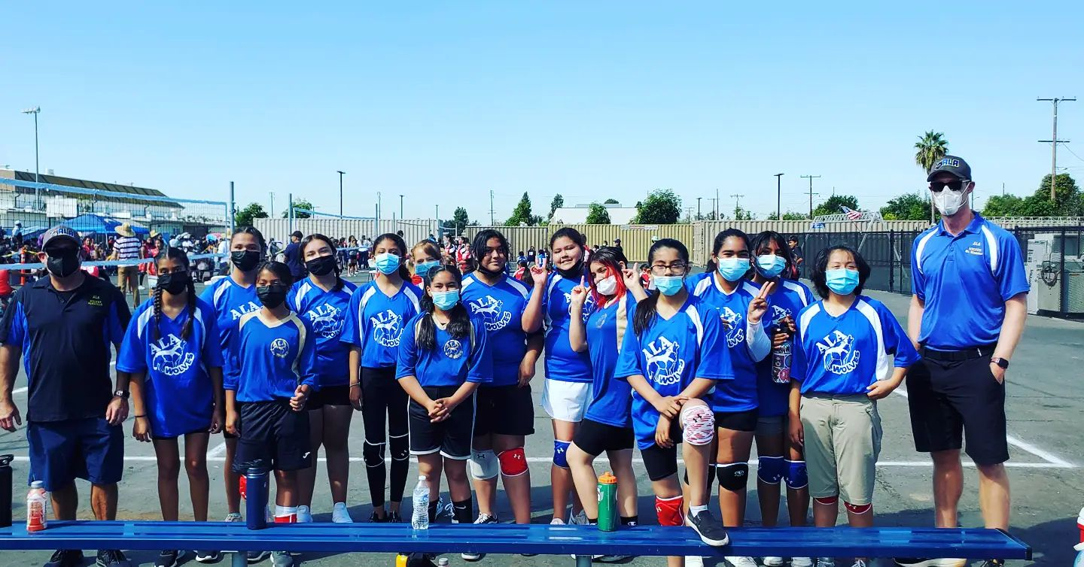
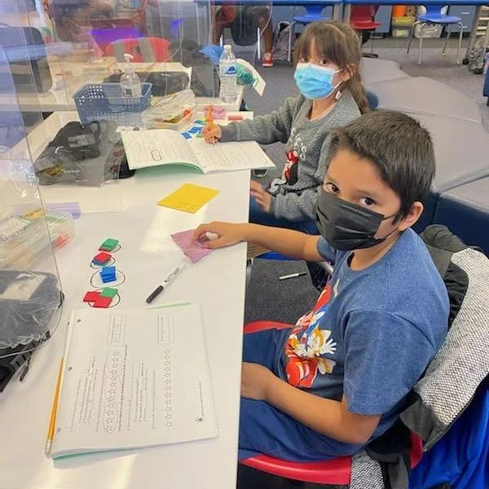
EXPENDITURES
Certificated Salaries
Classified Salaries
Employee Benefits
Books and Supplies
Other Outgo

Slide 6
COMPARABILITY
Charter Fund Revenue | Approved Budget | Unaudited Actuals | Variance | Explanation
LCFF Resources | $5.394 M | $5.394M | $0
Federal Revenue | $57,093 | $63,055 | $5,962 | Incr of $14,389 due to 09310, Title 1 carryover; decrease of $8,428 due to removing ESSER funding
Other State Revenue | $973,987 | $920,212 | ($53,775) | Incr of $11,837 for mandated costs and $34,408 for 09610-ASES award adjustments; decor of $100,000 for removal of 097339 - College and Career Readiness that were budgeted in June 2024 when received from the state
Other Local Revenue | $244,288 | $80,000 | ($164,288) | Decr due to the reversal of CTE incentive grant - 2023-2024 Original Budget was fully spent by June 2024
Total | $6.669M | $6.457 M | ($212,101)

Slide 7
COMPARABILITY
Charter Fund Expenditures | Approved Budget | Unaudited Actuals | Variance | Explanation
CE and CL Salaries | $4.879 M | $5.452 M | ($572,933) | Incr due to 2024-2025 3% SAEA Salary Increase and 3% one-time and retro (certificated) Increase mostly in adjustments to regular salaries and vacancies (classified)
Employee Benefits | $2.311 M | $2.504 M | ($192,981) | increase due to salary changes noted above
Books and Supplies | $228,364 | $224,644 | $3,720 | Decrease due to removing 093213 budget (ESSR) as grant was spent by June 2024
Services and Other Operating Costs | $265,852 | $363,184 | ($97,331) | Increase due to 2024-2025 Project Kinship agreement and field trip admissions per enrollment
Indirect Costs | $409,014 | $462,040 | ($53,026) | Increase due to indirect cost adjustment
Total | $8,064 M | $7.024M | ($575,741)

