Slide 1
SAUSD Access for all
Parent Meeting Presentation

Slide 2
SAUSD Access for All
Through the LCAP process, SAUSD has established a goal to support student access to the use of digital resources in support of learning.
The first step in meeting this goal is to provide students in grades 6-8 with a mobile device for use during the 2014-15 school year, and expanding to 5th and 9th grade in 2015-16.
#SAUSDaccessforall

Slide 3
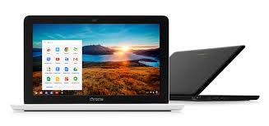
HP 11 Chromebook
Exynos 5 Dual processor
16 GB solid state drive
2 GB RAM
11.6” display
Chrome OS
Google Apps
Internet access monitored while at school and away through remote filtering system
Protective sleeve

Slide 4
iPad Mini (McFadden, Santiago, Sierra, Willard)
16GB
7.9” touchscreen
iOS 8
Internet access monitored while at school and away through remote filtering system
Learning apps
Protective holder

Slide 5
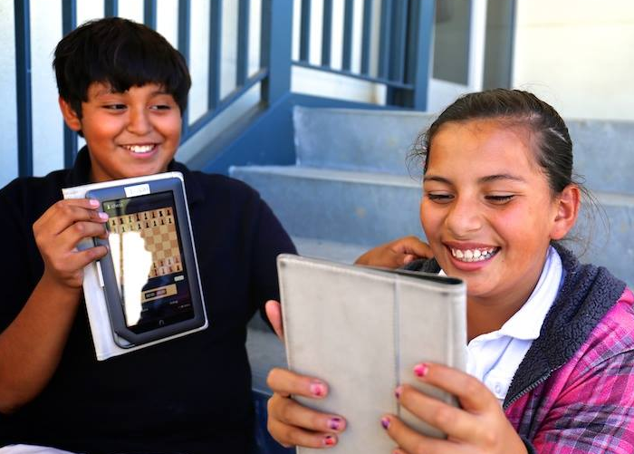
SAUSD Filter
Lightspeed
Filtering
Student internet requests are filtered at school and at home using the same process.
Student Request
Website
Filtered Sites Delivered

Slide 6
Digital Citizenship & Cyber Savvy Curriculum
All students will learn what it means to be a Digital Citizen and Internet Safety before receiving a mobile device for use.
Students in Kindergarten through 4th grade will be taught from grade level appropriate material which can be found on the District’s website, through the District-created Cyber Savvy curriculum.
Students in grade 5-8 will use an online program called EverFi, with grades 9-12 using either the online or district curriculum.

Slide 7
21st Century Skills – Essential skills for all students
Collaboration
Demonstrate ability to work effectively and respectfully with diverse teams
Communication
Exchanging thoughts and opinions with peers, educators, professionals, etc.
Critical Thinking
Disciplined thinking that is clear, rational, open-minded, and informed by evidence
Creativity
Be innovators of original ideas through imagination

Slide 8
Responsibilities
Care of Device
When not in use place in standby mode with screen off.
Place device on a flat, solid surface when in use.
Avoid eating or drinking around the device to prevent damage.
Handle screen with care to avoid scratching, cracking, or breaking.
Never attempt to repair, reconfigure, or modify.

Slide 9
Responsibilities
Care of Device
Avoid exposure to extreme temperatures, hot or cold.
Keep away from magnets and magnetic fields, which can erase or corrupt data (for laptops).
Disconnect device from power outlet before moving or cleaning.
Do not leave in vehicle.
iPads must stay in district issued case.

Slide 10
Damaged/Lost/Stolen Devices
Damaged – Any damage to a device will result in partial or full replacement cost of the device.
Lost – If a device is lost during school hours, it must be reported to school administration. If it is lost during non-school hours, it should be reported to a parent/guardian.
Stolen – If a device is stolen during school hours, it must be reported to the school administration immediately. If a device is stolen during non-school hours notify a parent/guardian as well as the local authorities.
If an insurance claim needs to be filed, contact your school – a school representative will be filing your claim.
SAUSD assumes no financial responsibility for any device that is damaged, lost, or stolen.

Slide 11
Insurance Options
Worth Ave. Group, and Insure Apple iPad/Chromebook are insurance providers.
Coverage length is for one year from the time of purchase
Ways to obtain insurance – online, mail, phone.
Fliers are available at your school sites.
Insurance only covers the iPad mini or Chromebook.

Slide 12
Parent/Guardian Expectations
Monitor use and care of device
Make students more responsible
Check internet history and no private browsing
Help educate about being online
Parent resources:
Common Sense Media – commonsensemedia.org
Onguard Online – onguardonline.gov
SAUSD Parent Portal/Internet Safety Resources
http://www.sausd.us/Page/15948

Slide 13
Three Reminders
Mobile Device
Students use this to access content. The mobile device may be an iPad mini or a chromebook.
Gooru/Canvas/Google Classroom
An online platform where some content is created and stored.
Aeries/Parent Portal-Student Portal
Where parents and students go to see student information such as attendance and grades.

