Slide 1
Preschool Programs Early Childhood Education and Head Start August 24, 2010
Jane Russo, Superintendent
Herman Mendez, Assistant Superintendent, Elementary Ed.
Doreen Lohnes, Assistant Superintendent Pupil Support Services
Janneth Linnell, Early Childhood Education Coordinator
Charlotte Ervin, Head Start Coordinator
Mark Bello, Mitchell Child Development Center Principal

Slide 2
Agenda
Programs
Special Education Programs
Locations
Student Growth
Services
Outcomes
Support
Highlights

Slide 3
Programs
Early Childhood Education Department
Head Start | Even Start Preschool | Pre-K Family Literacy | Kinder Readiness/ Title I | State Funded Preschool
$2,711,913 | $120,750 | $712,978 | $2,126,915* | $970,614
448 children | 48 children | 192 children | 528 children | 288 children
Federal program Eligibility based on income Serves preschool children (3 to 5) Delegate agency of OCHS | Federal program awarded through CDE Serves preschool children (3 to 5) Eligibility based on income Parent education/ parenting class required | State funded program Serves pre-kinder children (4 yr olds) Eligibility based on income Family Literacy component required | OCCFC and Title I funded Serves pre-kinder children (4 yr olds) Eligibility based on attendance area Funded services enhance all state programs * Projected allocation for 2010-11 | State funded program Serves pre-kinder children (4 yr olds) Eligibility based on income

Slide 4
Special Education Programs for 382 Preschool Students
Early Start Infants | Full Inclusion Preschool Programs | Mild Moderate Programs | Moderate Severe and Medically Fragile Programs | SUCSESS Autism Programs
34 children | 44 children | 163 children | 27 children | 114 children
Birth to Three years of age 2 Teachers/2 Instructional Assistants Housed at the Mitchell CDC site | Serves preschool children (3 to 5) Work closely with Head Start and ECE to place students that benefit from 100% participation with typical students Housed at Mitchell CDC, Roosevelt and Taft Elementary sites | Serves 3-5 year olds Located at Garfield, Esqueda, Harvey, Hoover, Lincoln Washington, Taft, Heroes and Santiago | Serves 3-5 year olds Students with moderate to severe needs Students with severe medical needs | 10 SUCSESS Programs that serve children with Autism Research based interventions Intensive Behavior Intervention Clinic (IBI)
3

Slide 5
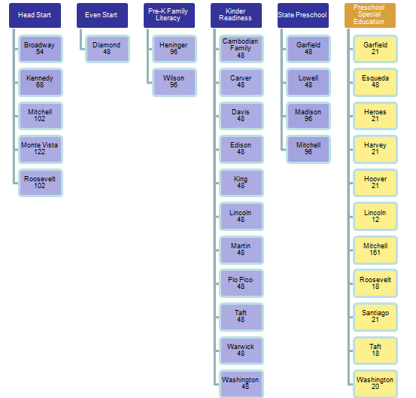
Locations

Slide 6
Student Growth
 |  | Projected
Funding Sources | 2007-2008 | 2010-2011
Pre-K Children Served | 1,258 | 1,504
Kindergarten Enrolled | 4,524 | 4,100
% of Total K Enrollment Served w/ Preschool Services | 28% | 36%
SR Nurse Expansion (SRN) | $ 203,940.00 | $ 210,815.00
OCCFC
Program Grants | $ 106,425.00 | $ 56,000.00
OCCFC
Kinder Readiness | $ 1,107,115.00 | $ 820,000.00
OCCFC
School Readiness Initiative | $ 175,100.00 | $ 175,100.00
Even Start | $ 375,000.00 | $ 120,750.00
U.S. Dept of Education
State preschool (CPRE/CPKP) | $ 1,131,038.00 | $ 1,683,592.00
California Dept. of Education
Title 1 | $ 1,000,000.00 | $ 1,000,000.00
U.S. Dept. of Education
Head Start | $ 2,200,723.00 | $ 2,711,913.00
U.S. Dept. of Health & Human Services

Slide 7
Services
5 Essential Services Provided by District Preschools
Education
Parenting/Family Support/Parent Involvement
Nutrition, Health and Social Services
Schools’ Readiness/Transition
Governance and Quality Systems

Slide 8
Outcomes
Desired Results Developmental Profile (DRDP-R)
Percent of Children “Building” or “Integrating” on DRDP-R, 2009-10

Slide 9
Support
Curriculum/ Instruction Support | Facilities Support | Staff Development Support
MIND Institute | Warwick Square Apartments | Orange County Department of Education
Orange County Department of Education | Cambodian Family | California State University Fullerton
UCI- Jumpstart and CSUF-Jumpstart | Orange County Children and Families Commission | Orange County Children and Families Commission
THINK Together
Orange County Children and Families Commission

Slide 10
Highlights
Head Start program successfully completed a Federal audit with no findings
Head Start implemented Employee Tuition Reimbursement Program
Head Start streamlined program governance to include better communication to Board of Education
Early Childhood Education Department (ECE) coordinated services to maximize leveraging opportunities
ECE collaborated with Think Together to provide Summer Preschool Academy, which serves 528 incoming kindergarten children without preschool experience at Carver, Davis, Diamond, Edison, Heninger, King, Lincoln, Lowell, Martin, Pio Pico and Washington
ECE is piloting and helping with the development of MIND Institute’s preschool math program
ECE will open an additional new full inclusion preschool classroom at Taft in collaboration with Special Education Department

Slide 11
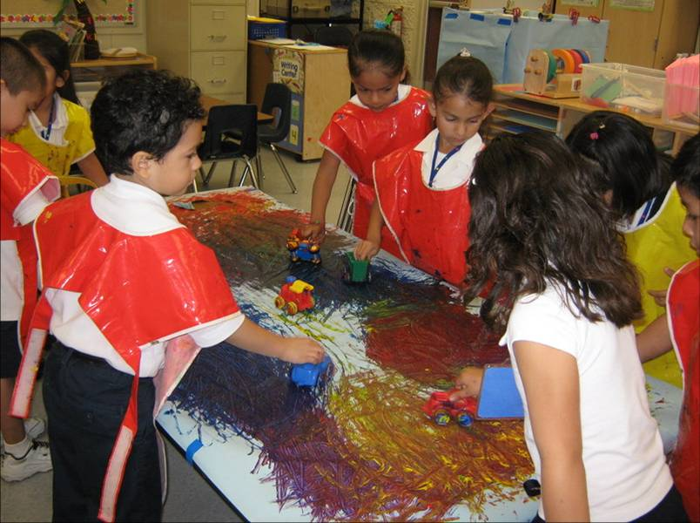
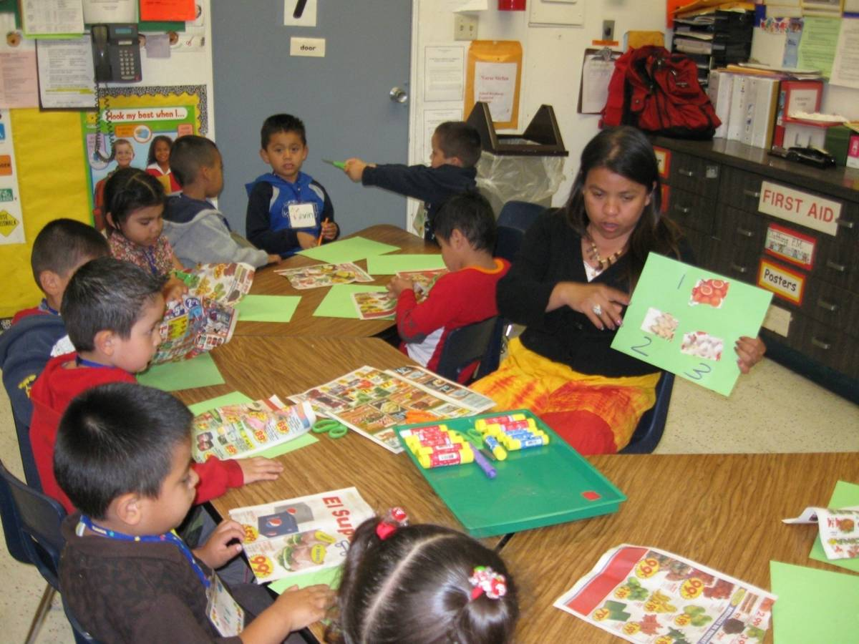
Thank you for your support!

