Slide 1
Monday, April 14, 2014
Wednesday, April 16, 2014

Slide 2
Agenda
Unit of Study: Probability
Reflection

Slide 3
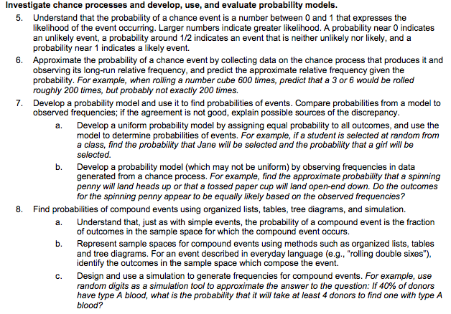

Slide 5
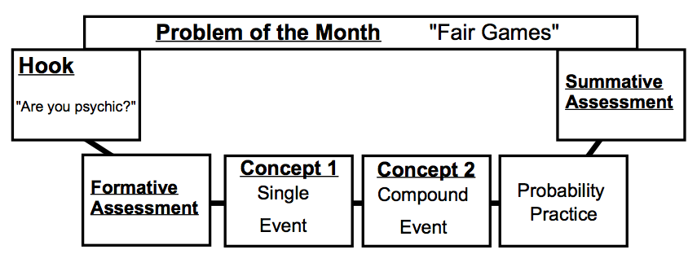
Math 7 – Probability Unit – Flow Map

Slide 6
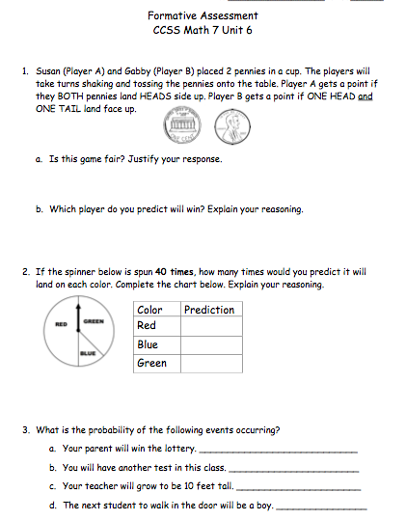
Math 7 – Probability Unit – Formative Assessment

Slide 7
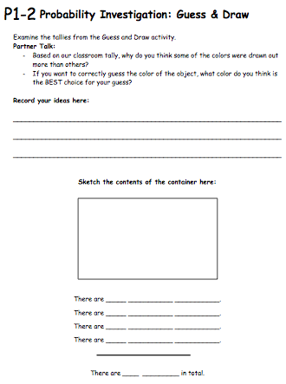
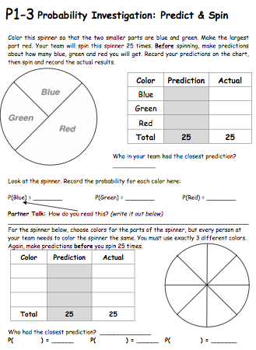
Math 7 – Probability Unit – Concept 1: Single Event

Slide 8
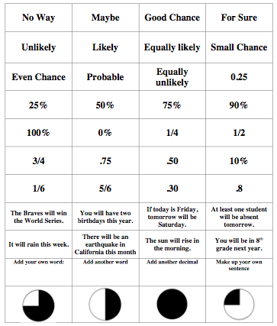
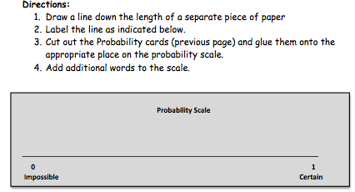
Math 7 – Probability Unit – Number Line Activity

Slide 9
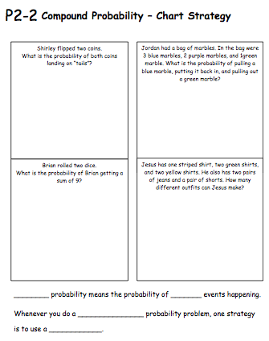
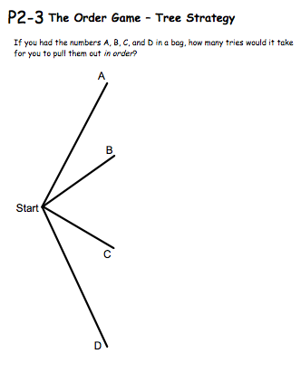
Math 7 – Probability Unit – Concept 2: Compound Event

Slide 10
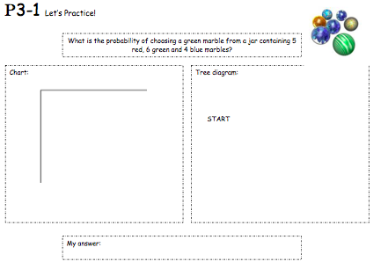
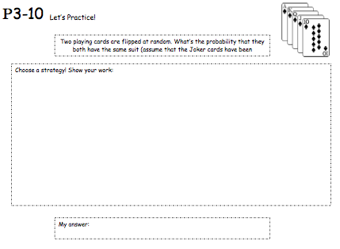
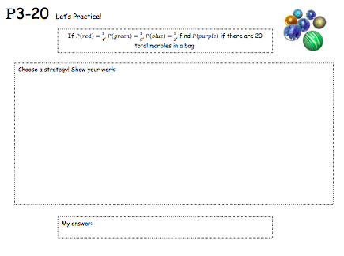
Math 7 – Probability Unit – 20 Practice Problems (Single and Compound)

Slide 11
Problem of the Month (POM)
The POM is divided into five levels, Level A through Level E, to allow access and scaffolding for the students into different aspects of the problem and to stretch students to go deeper into mathematical complexity.

Slide 13
POM: Explanation/Status Posters & Gallery Walk
Students should place their concluding thoughts on an explanation poster for a level they feel they have completed AND/OR their current thoughts on a status poster for a level they are still exploring. Select a docent who stands next to the poster and answers questions. Groups walk from poster to poster looking for different approaches to the problems, any new insights, etc.

Slide 14
Mars Tasks
These tasks are performance tasks designed and tested by the Mathematics Assessment Resource Service, or MARS. The MARS tasks demand substantial chains of reasoning and non-routine problem solving, and can be used to help students build facility with the Standards for Mathematical Practice described in the Common Core State Standards for Mathematics.
Most MARS tasks begin with questions slightly below the level of difficulty of the grade level, meant to lead students into the concept and to activate their prior knowledge. Most tasks end with questions designed to stretch students’ thinking and to provide them with an opportunity to connect their learning to new concepts. These portions of the task provide information on how well students can combine what they know with novel ideas. They also give both teacher and learner information about knowledge students may have of content covered in future topics.

Slide 15
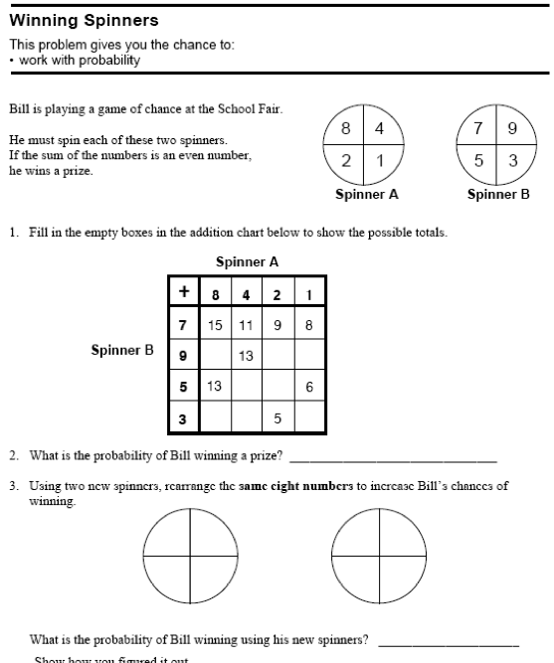

Slide 16
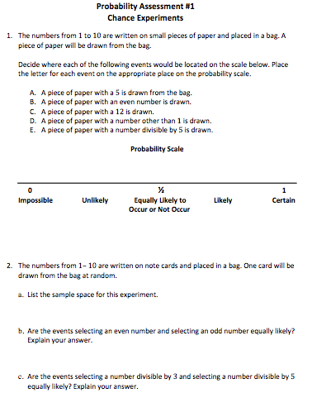
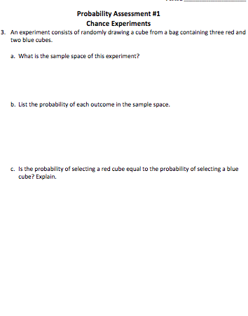

Slide 17
Reflection
What strategies do you find most engaging and productive for students? Teachers? Explain.
2. What do you find most challenging for students? Teachers? Explain.
What support will you find helpful to successfully implement the Unit? Explain.

Slide 18
A Special Thank You to…
S. Bayouk, Spurgeon
A. Earl, Mendez
E. Erhuy, Santiago
C. French, Villa
C. Yusi, Santiago

