Slide 1
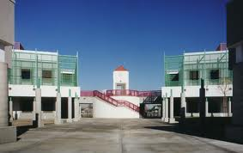

Welcome to Mrs.Call
And Mrs. Kinan’s
Second Grade Class!

Slide 2
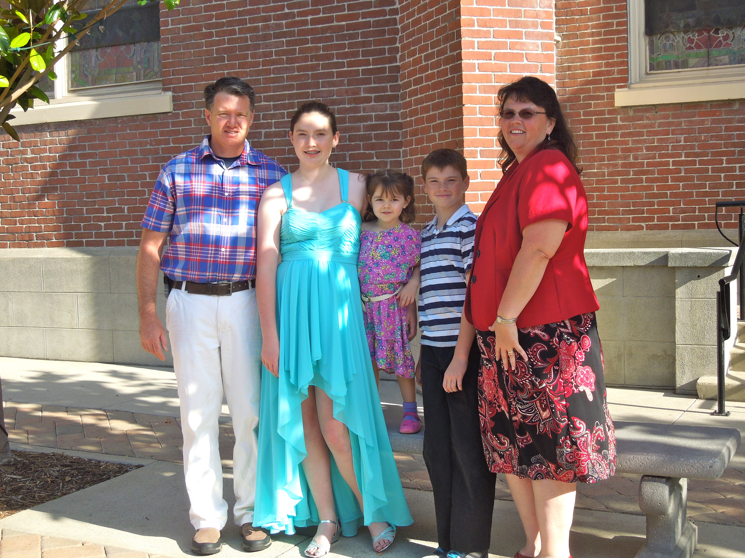
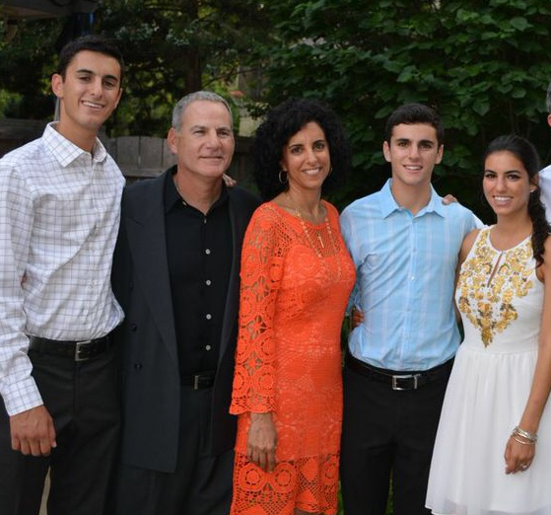
Our Families
Mrs. Kinan
Mrs. Call

Slide 3

School Hours: 8:10 a.m. – 2:14 p.m. Monday, Tuesday, Thursday,
and Friday
Modified Wednesdays out at 1:09 p.m.
Attendance: Students need to come daily except in cases of sickness or a death in the immediate family. If your child has a doctor or dentist appointment, please bring them before or after the appointment so they can get credit for coming to school, even if only for half a day. IF YOUR CHILD HAS A FEVER, PLEASE DO NOT SEND THEM TO SCHOOL FOR AT LEAST 24 HOURS AFTER IT HAS BROKEN (without medication).
IF ABSENT
*1. Call the absence line at (714) 647- 2895 or
2. Send a note with the child’s name, date and reason for absence
3. Tell the teacher in person
*Please call the same day as the absence, otherwise the teacher cannot fix it.

Slide 4

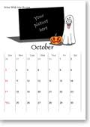

Slide 5
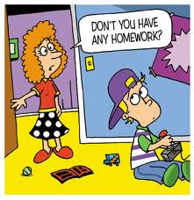
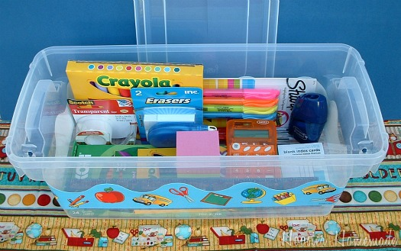
Homework Schedule:
Mathematics – daily (Monday-Thursday)
B. Comprehension/Grammar/Phonics (Reading Worksheet)- daily
(Monday-Thursday)
Reading – 30-60 minutes a day (Monday-Saturday)
- Your child can read decodables, a library
or other personal book.
- Make sure the book is at the right reading level
(not too hard or easy)
Please write the title on the homework sheet.
*Please SIGN that your child has read each decodable book twice.

Slide 6
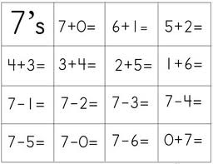
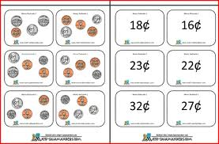
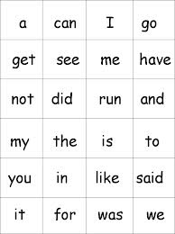

Slide 7



Accelerated Reader
Our school goal this year is 90 million words read!
1. Please make sure your child is reading their AR/library book at least 3-4
times and is ready for a test before the next library day. Our library time is
Thursday from 8:45-9:15 am. Your child is on grade level if they are reading at
least orange.
2. A passing score is 60% or above. 60%=0.3 points, 70%-80%=0.4 pts., 90%-100%=.5
pts. in general. Chapter books will earn more points/word count.
**Your child will not receive word count or points if they do not pass the exam.
3. Please have your child keep the library books and decodables in their backpacks so
they can read at home and at school when they have free time.
4. Sign up with AR Home connect to check on your child’s progress.
Jiji/ST Math
We will be allowing the students to play games at home later in the
year. Please do not allow anyone to play FOR your child.
This program is designed for them to work it out on their own.
The log on directions are in your Information packet.

Slide 8



Walker

Slide 9
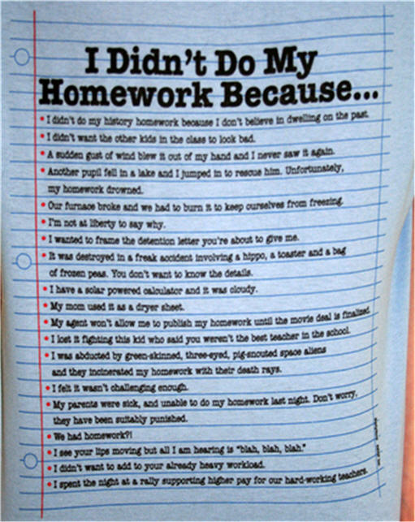

Slide 10


Slide 11
RAINBOW WORDS
1st-Test on reading words 2nd- Test on spelling words 3rd- sign both and return to teacher

Slide 12
Parent Duties
Help with/check your child’s daily homework.
Sign your child’s homework page, reading log, and decodable books.
3. Look in your child’s homework folder daily for important notes, take out unnecessary papers and make sure they bring it back DAILY.
4. Read to/with your child (in any language), and provide books (book order or checkout from the Walker or Santa Ana Library) for them.
5. Bring your child to school on time and in uniform.
6. Make sure they have a good breakfast and brush their teeth.
Put your child to sleep between 8:30-9:00 pm at the latest.
8. Teach your child their phone number, address, and birth date.
Teacher Helpers (optional)
Send tissue, Lysol wipes, and hand sanitizer to help us keep germs away.
Buy your child many pencils and a small pencil sharpener.
Send Ziploc bags (small and large) or prizes for our prize box.
Volunteer to help in the classroom/school.

Slide 13
If you have any questions or concerns:
Make an appointment with the teacher for before/after school.
Email us at brenda.call@sausd.us or karen.kinan@sausd.us
Write us a note.
Call us after school at 714-647-2800
In order for your child to grow and learn the most this year, we must all work together as a team!
Student
Triangle of Success
Parent
Teacher

