Slide 1
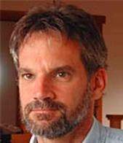
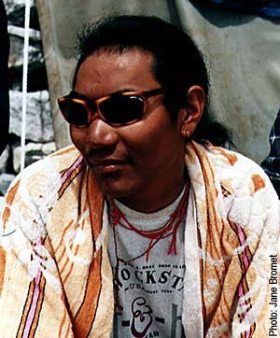
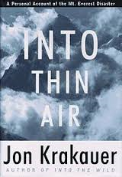
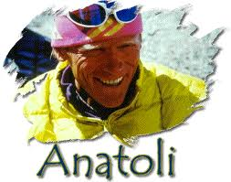
Unit 3: Lesson 3
Different Perspectives of the Mt. Everest Disaster

Slide 2
Big Idea/Essential Questions
Big Idea: Change can be unexpected
Essential Question:
Why do people have different perspectives of the same event?

Slide 3
Circle Map:
Multiple Perspectives of the Same Event
Resource 3.1
It’s an oil conspiracy!
September 11th
Terrorism was committed to scare Americans
George Bush wanted to finish his father’s war

Slide 4
Source: MountainZone.com A Dialogue of Multiple Perspectives
Authors: Jon Krakauer (climber/ journalist), Anatoli Boukreev (guide), Lopsang Jangbu (Sherpa)
Genre: Website (MountainZone.com)
Point of View: First person

Slide 6
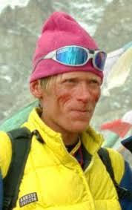
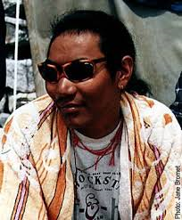
Krakauer’s Original Article: Resource 3.2
Anatoli Boukreev (guide) and Lopsang Jangbu (Sherpa) disagreed with statements made by Krakauer in his original article.
Let’s look at what he said about them, then we’ll read their responses.

Slide 7
First Reading: “Anatoli Boukreev Responds to Jon Krakauer”
Turn to Resource 3.3 in your workbook and we will read and annotate the article together.

Slide 8
Do/Say Chart: Resource 3.4

Slide 10
EXAMPLE:
(Resource 3.5)
article
“Anatoli Boukreev Responds to Krakauer”
Anatoli Boukreev
discusses
his decisions and actions on Mt. Everest
believes that
Krakauer judged him too harshly and was mistaken in some of his opinions.
Firstly, Boukreev explains his decision to descend from the summit before all the climbers had arrived. He believes that if he hadn’t, he wouldn’t have been able to go back later to help rescue those stuck in the storm. Secondly, Boukreev defends the fact that he was climbing without oxygen. As an experienced climber, he felt he didn’t need it. He also proves he was appropriately dressed in climbing gear similar to that of the other climbers.
Boukreev
article
that his decisions and actions were not at fault under these circumstances.

Slide 11
Class Discussion
How did Boukreev’s experience differ from Krakauer’s? Does a different perspective on the same event change your opinion about “Into Thin Air?”

Slide 12
Lopsang Jangbu Sherpa’s Response
Read Lopsang Jangbu’s article (Resource 3.6) with a partner, annotating the text.

Slide 13
Do/Say Chart: Resource 3.7

Slide 14
Academic Summary (Resource 3.8)
You will be summarizing the main point and arguments made by Lopsang Jangbu.
Use the Do/Say Chart to guide your writing.
You need to do this INDIVIDUALLY. This skill will be tested on your summative assessment.

Slide 15
(Resource 3.8)

