Slide 1
Change Can Be Unexpected Vocabulary
Proximity
Supplemental oxygen
Acclimatize
Ascend
Sherpa

Slide 2
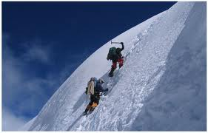
Proximity- the state of being near synonym-close
Example: His lack of proximity may have gotten in the way of his ability to evaluate the events of summit day.

Slide 3
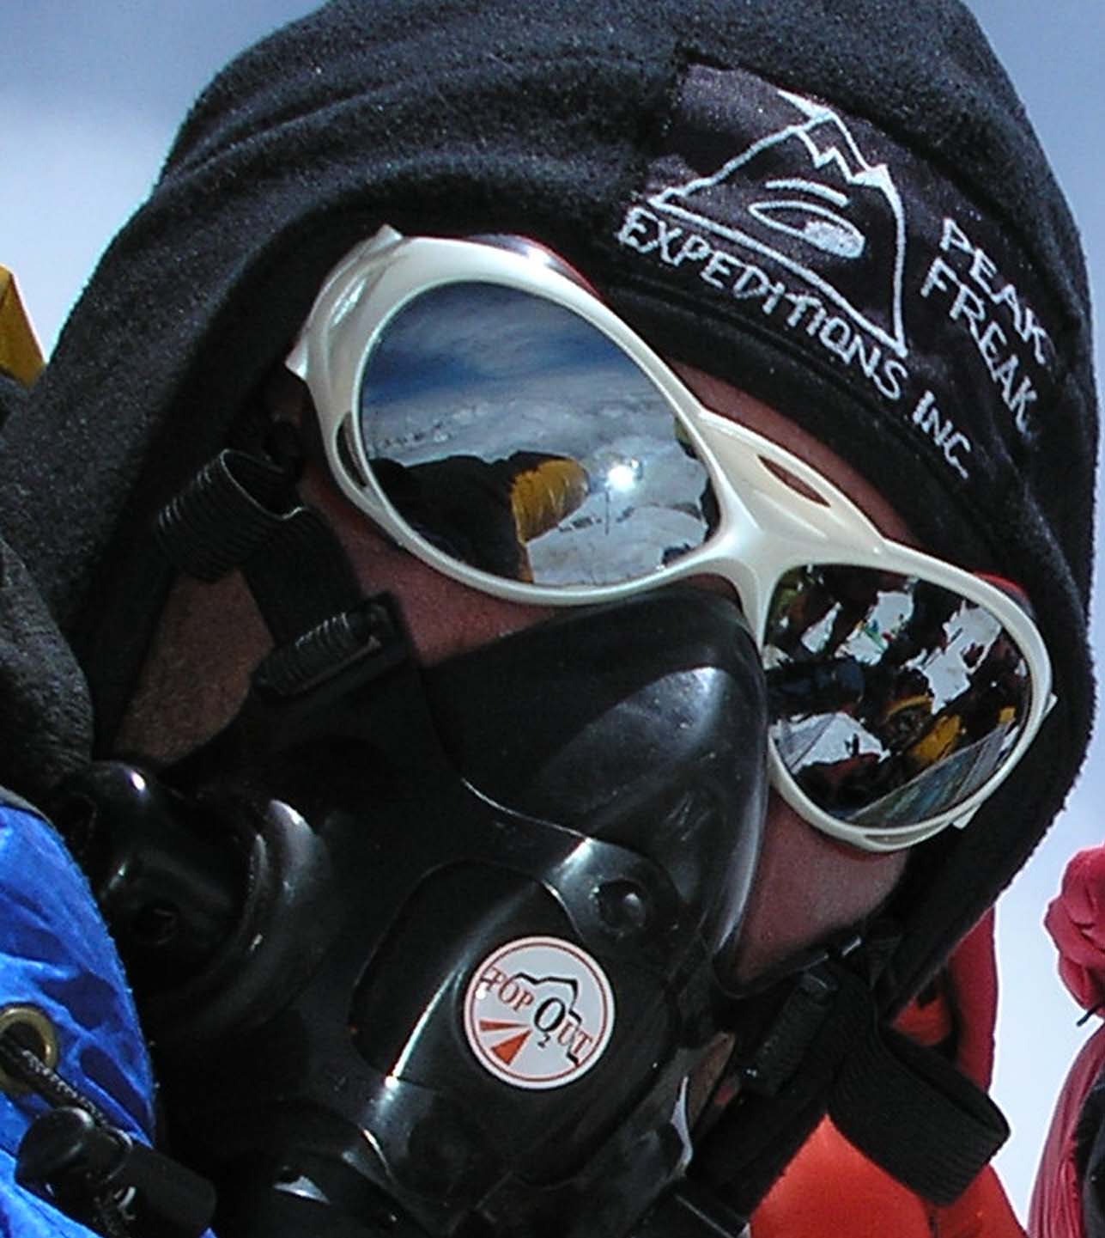
Supplemental - added to something else to make it complete synonym-extra
Example: I have summited seven of the worlds 14 mountains without the use of supplemental oxygen.

Slide 4
Acclimatize -to adjust or adapt to a new climate, place, or situation synonym- adjust
Example: In my experience it is safer for me, once acclimatized, to climb without oxygen.

Slide 5
Ascending -to rise or move toward the sky synonym-to rise
Example: As I was ascending, I was for a while climbing with Neil Beidelman.

Slide 6
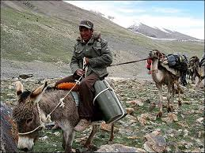
Sherpa -a member of a people who live in the Himalayas and who are often hired to help guide mountain climbers and carry their equipment. synonym-guide
Example: I passed four of the client climbers and four of the expedition sherpas.

