Slide 1
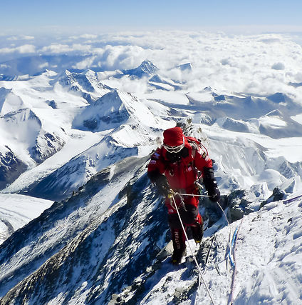
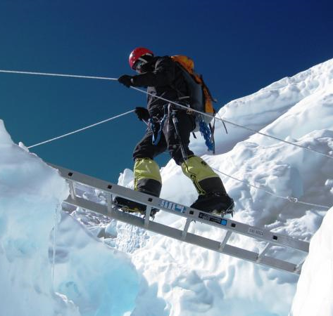
Unit 3: Lesson 2
Irony in “Into Thin Air”

Slide 2
Big Idea/Essential Questions
Big Idea: Change can be unexpected
Essential Questions:
How do people respond to unexpected change?
How do author’s use irony to create a feeling of mystery, suspense, or surprise?

Slide 3
Text: “Into Thin Air”
Author: Jon Krakauer
Genre: Magazine Article (Outside Magazine), later expanded into a non-fiction book
Point of View: First person
Jon Krakauer participated in the climb up Mt. Everest. This is therefore an example of participatory journalism.

Slide 4
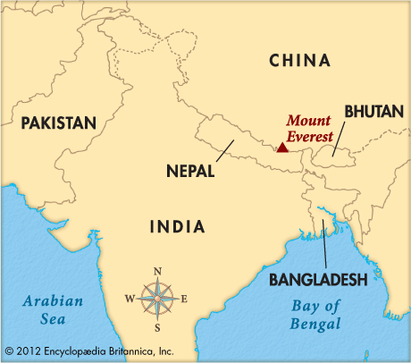
Background Information
Read
textbook
page 350
Review
pictures
on page
351

Slide 5
Key Words Essential to Understanding
acclimatize: to adapt to a new temperature, altitude, climate, environment, or situation
apex: the uppermost point; vertex
ascend: to move upward
descend: to move downward
Sherpa: a member of a Tibetan people living on the high southern slopes of the Himalayas in eastern Nepal and known for providing support for foreign trekkers and mountain climbers

Slide 6
Mt. Everest Video

Slide 7
Class Discussion: “Into Thin Air”
What literal and figurative meanings does this title have?
Literal: the altitude causes the air to become thin
Figurative: the title may refer to people vanishing or disappearing “into thin air”

Slide 8
Quickwrite with Three-Step Interview (Resource 2.1)
Quickwrite: Have you ever risked your life for an adventure or a thrill? If so, what did you do and why? If not, why do you think people are willing to risk their lives for adventure?

Slide 9
Three-Step Interview Process
Step 1: Using the quickwrite prompt,
Student A interviews Student B and
Student C interviews Student D.
Students A and C will listen
carefully to the responses because
they will be repeating their partner’s
response to the table group.

Slide 10
Three-Step Interview Process
Step 2: Student B now interviews Student A
and Student D interviews Student C.
Students B and D will listen carefully
to the responses because they will
be repeating their partner’s
response to the table group.

Slide 11
Three-Step Interview Process
Step 3: Each person shares, round robin to
the table group, his/her partner’s
response to the quickwrite question.

Slide 12
Read: “Into Thin Air”
Answer text-dependent questions during the reading (Resource 2.2)

Slide 13
Quickwrite with Three-Step Interview (Resource 2.3)
Quickwrite: Many unexpected events happened to the climbers on Mt. Everest. Pick one person and discuss their reaction(s) to the unexpected events and how this experience changed their life.

Slide 14
Three-Step Interview Process
Step 1: Using the quickwrite prompt,
Student A interviews Student B and
Student C interviews Student D.
Students A and C will listen
carefully to the responses because
they will be repeating their partner’s
response to the table group.

Slide 15
Three-Step Interview Process
Step 2: Student B now interviews Student A
and Student D interviews Student C.
Students B and D will listen carefully
to the responses because they will
be repeating their partner’s
response to the table group.

Slide 16
Three-Step Interview Process
Step 3: Each person shares, round robin to
the table group, his/her partner’s
response to the quickwrite question.

Slide 17
Close Read with Depth and Complexity Frame
Turn to Resource 2.4 and read the passage on your own.
Complete the Depth and Complexity Frame (Resource 2.5)

Slide 18
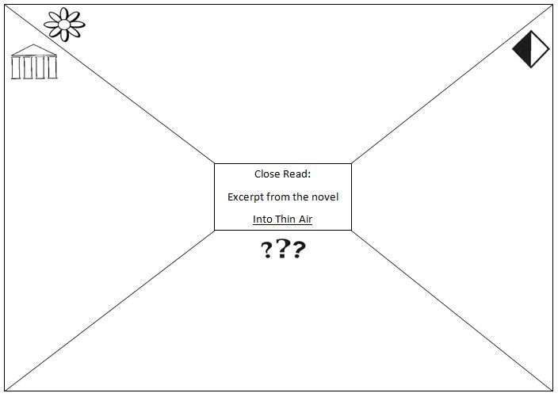
DETAILS
B
I
G
I
D
E
A
E
T
H
I
C
S
UNANSWERED QUESTIONS

Slide 19
Depth & Complexity Frame
Details (flower): fill in this section with details you find in the text.
Big Idea (columns): What is the main idea of the passage?
Ethics (black & white square): What is morally questionable about this passage? What issues does it deal with?
Unanswered Questions (???): What questions does this passage bring up? What questions are you left with after reading?

