Slide 1
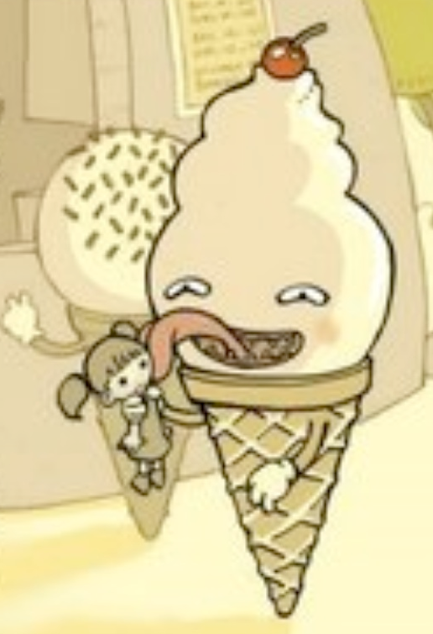
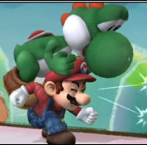

Unit 3: Irony
Change Can Be Unexpected

Slide 2
Circle Map: Unexpected Change
Examples of unexpected change that can happen in life
Unexpected Change

Slide 3
Think-Write!
Writing Prompt (Resource 1.1)
Describe an unexpected change that you experienced with someone else.
    What was the change and why was it unexpected?
    Discuss how you responded to the change and how the other person responded.
    How were your perspectives on the change different? The same?
  ~ You will have 5 minutes ~

Slide 4
Pair-Share!
With your partner:
Student A shares his/her story with Student B.
Student B asks at least two clarifying questions about Student A’s story.
      Optional sentence frames:
      How did you feel when . . . ?
      Why did you . . .?
      Why do you think the other person . . .?
Then Student B shares his/her story with Student A, and Student A asks clarifying questions of Student B.

Slide 5
Unit Overview
You will be focusing on three essential questions. →
You will be analyzing how the characters had different perspectives about unexpected change. ↓
Big Idea: Change Can Be Unexpected
1. Irony
2. Essential Questions
3. Perspective
↑
You will be looking at how irony affects the story and the characters.
← You will be reading two stories that are about the Big Idea.

Slide 6
1. Irony
Definition:
Irony is when what happens is the opposite of what was expected.

Slide 7
1. Irony (continued)
You will be learning the three types of irony:
      Dramatic Irony
      Situational Irony
      Verbal Irony

Slide 8
2. Essential Questions:
What are they?
Essential Questions:
Are important to understanding the Big Idea
Do not have a simple answer

Slide 9
2. Essential Q’s Continued
Your essential questions for the Big Idea of this unit, “Change Can Be Unexpected”:
How do people respond to unexpected change?
How do authors use irony to build mystery, tension, and surprise?
Why do people have different perspectives on the same event?

Slide 10
3. Perspective
What is perspective?
  Perspective is the way people look at or think about something.
Example: Maria and Julia are sisters having a fight over a dress.
  Maria’s perspective is that Julia should not wear the dress because it was her birthday gift.
  Julia’s perspective is that she should be able to wear the dress because Maria never wears it.

Slide 11

Your first reading (fiction):
“Lamb to the Slaughter” by Roald Dahl
Synopsis: A pregnant, loving wife is given shocking news by her husband.
Interesting Fact: Roald Dahl also wrote James and the Giant Peach, Matilda, and Willy Wonka and the Chocolate Factory.

Slide 12

Your second reading (non-fiction):
From “Into Thin Air” by Jon Krakauer
AND
“Responses to Krakauer”, from Anatoli Boukreev and Lopsang Jangbu Sherpa
A group of men and women experience tragedy while climbing Mount Everest . . . and they all have a different perspective of what really happened.

Slide 13
Now, back to irony . . .
Let’s talk about the three types of Irony:
Turn to Resource 1.2

Slide 14
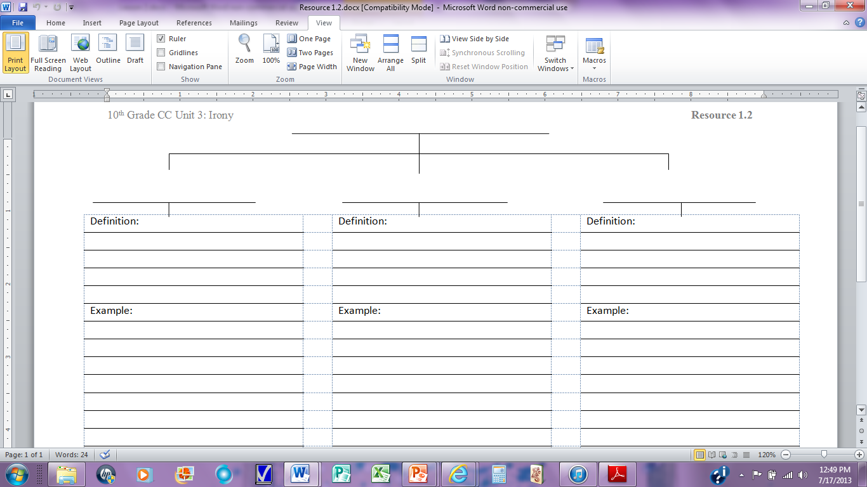

Slide 15
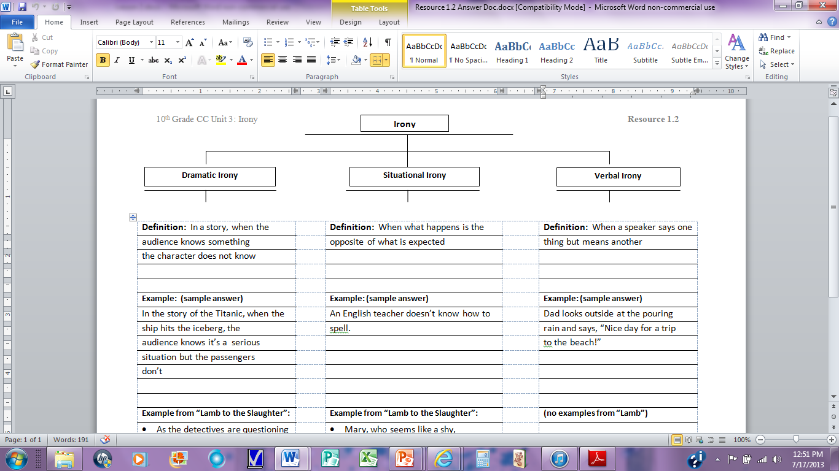

Slide 16
Did you learn it?
Complete Irony Practice Worksheet:
    Resource 1.3

Slide 17
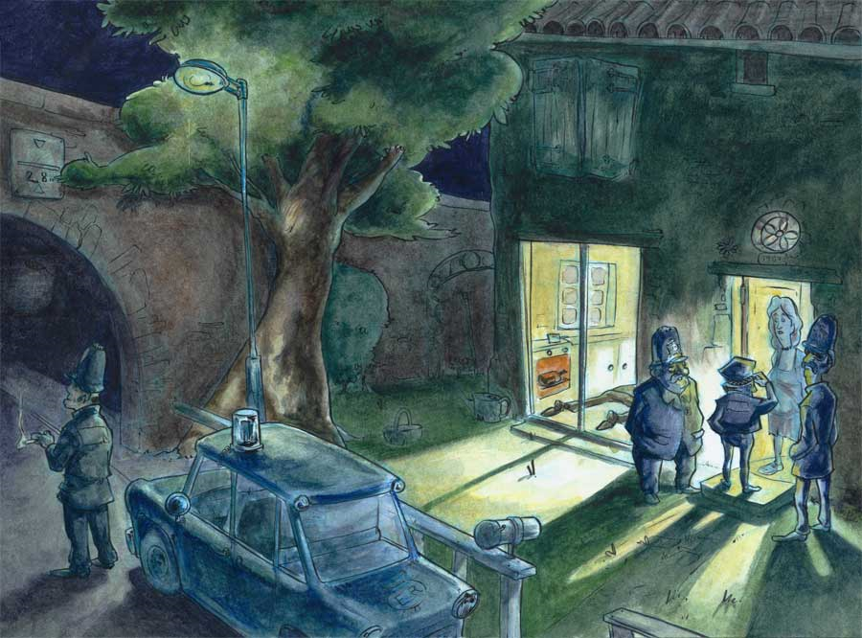
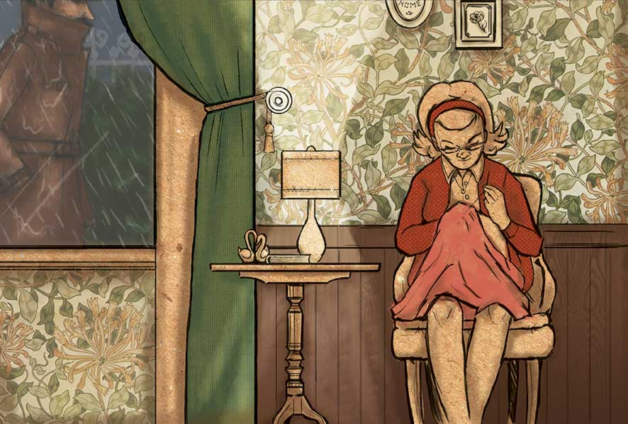

Lamb to the Slaughter
By Roald Dahl

Slide 18
Irony Review
Discuss with your partner:
  What are the three types of irony?
  How are the three types of irony different from each other?

Slide 19
Extended Anticipatory Guide
(Resource 1.4)
Independently: Place a check in the Agree or Disagree column for each statement. Be prepared to explain your responses.
With a Partner:
  Student A reads statement #1 and then shares his/her opinion and reason while Student B listens (no discussion at this point).
  Then, Student B acknowledges Student A’s response and then shares his/her own opinion.
  Continue, alternating who goes first until you reach the last statement.

Slide 20
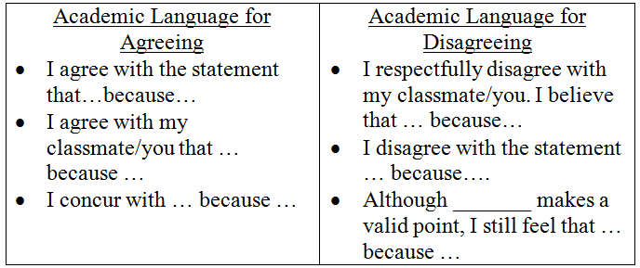
Extended Anticipatory Guide

Slide 21
Essential Questions
During our reading, we’ll focus on these two essential questions:
  How do people respond to unexpected change?
  How do authors use irony to build mystery, tension, and surprise?

Slide 22
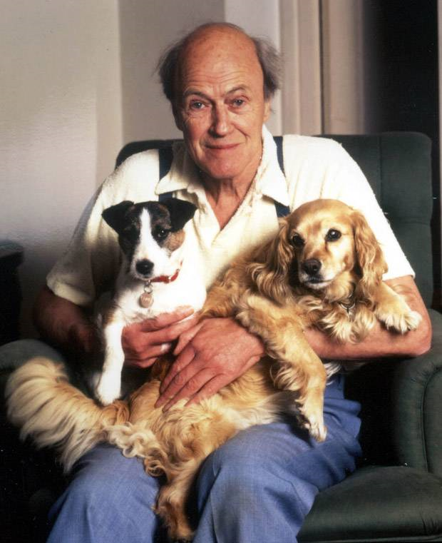
Text: “Lamb to the Slaughter”
Author: Roald Dahl
Genre: short story
Point of view:
third person limited

Slide 23
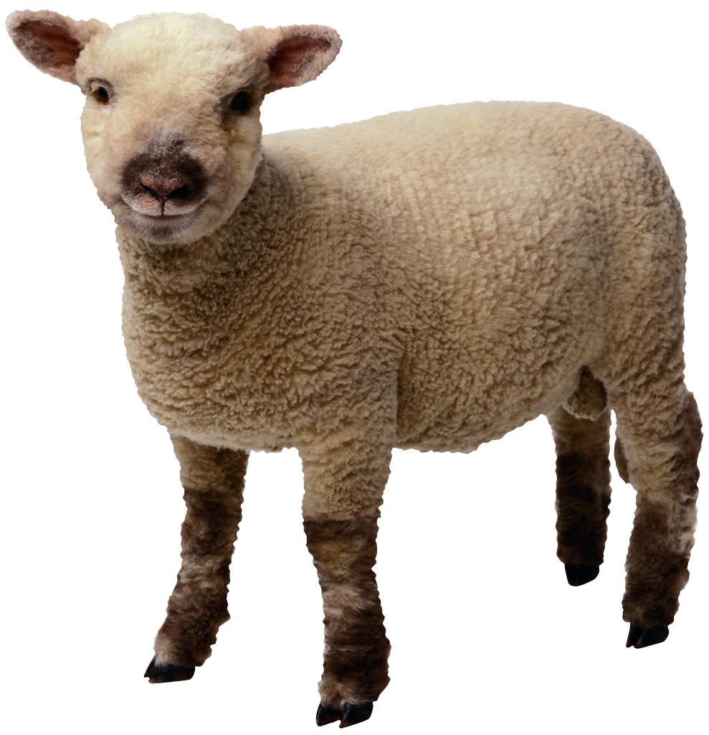
Title Connections:
“Lamb to the Slaughter”
Discuss with your partner:
  What does it mean to be a “like a lamb”?
  What does it mean to slaughter someone or something?

Slide 24
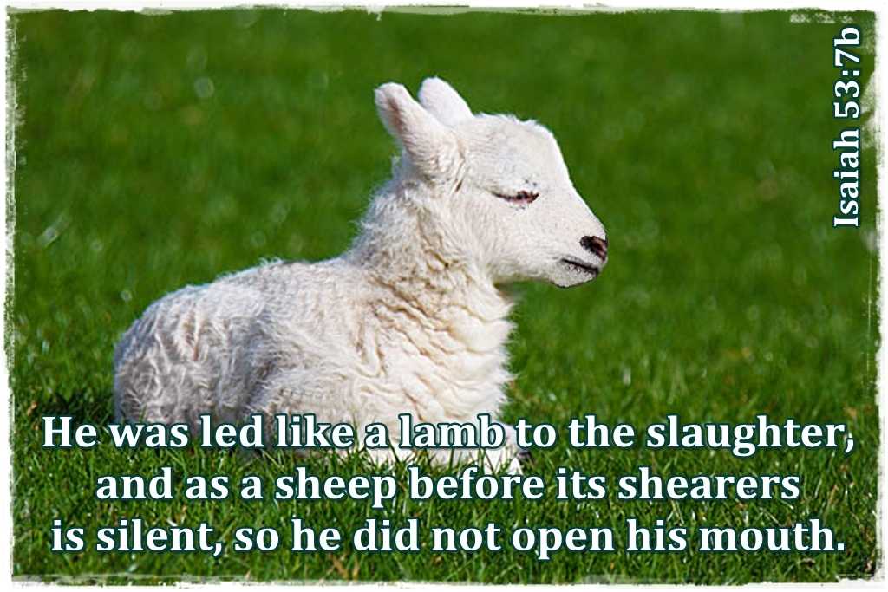
Idiom Origin
“Like a lamb to the slaughter”: means to do something in an unconcerned manner - unaware of the coming disaster
This is a Biblical allusion:
  Jeremiah 11:19: “But I was like
  a gentle lamb led to the slaughter”
  Comes from lambs being
  used as sacrifices

Slide 25
Reading with a Focus
Read paragraphs 1-24 aloud with a partner. Switch off by paragraph.
As you read, look for what kind of person Mary Maloney is. Underline anything that describes Mary’s character.
Text-Based Question #1: (Resource 1.6)
  Based on paragraphs 1-24, describe Mary Maloney’s character.

Slide 26
Describe Mary Maloney’s Character
Discuss with your partner what kind of person Mary Maloney is.
  Sentence Frames:
    Based on the story, Mary Maloney seems to be…
    Based on the story, Mary Maloney’s character can best be described as…
    So far in the story, Mary Maloney appears to be…
As a group, decide on 2-3 adjectives that best describe Mary.

Slide 27
Describe Mary Maloney’s Character
Placid: calm, peaceful
Tranquil: calm, composed
Luxuriate: “She loved to luxuriate in the presence of this man, and to feel—almost as a sunbather feels the sun—that warm male glow that came out of him.”
  Based on this sentence, discuss: what does “luxuriate” mean?

Slide 28
Reading with a Focus
Read Paragraphs 22-46.
Text-Based Question #2:
  Why is Mary’s violent action so unexpected? What evidence in the text makes her action surprising?

Slide 29
Sentence Frames
Mary’s violence was unexpected because…
I expected Mary to … Her action was unexpected because…

Slide 30
Ambiguity
ambiguity: an element of uncertainty in a text in which something can be interpreted in a number of different ways.
Discuss with a partner:
  How is the husband’s reason for breaking up with Mary an example of ambiguity?
  Sentence frames:
    The husband’s reason for leaving is ambiguous because…

Slide 31
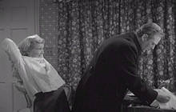
Predictions
Do you think Mary will get away with the murder?
How will she get away with it?

Slide 32
Reading with a Focus
Read paragraphs 47-82. As you read, look for instances of dramatic irony.
Text-Based Question #3: In paragraphs 47-82, how does Mary respond to the unexpected changes in her life? What does this reveal about her character?
Text-Based Question #4: For paragraphs 47-82, how is this section ironic? How does this irony create suspense in the story?

Slide 33
Reading with a Focus
Text-Based Question 5: In paragraphs 83-131, what happens to the murder weapon? How does Dahl assure his readers understand the irony of this event?
Text-Based Question 6: Think about the biblical allusion of the phrase “going like a lamb to the slaughter.” Why does Dahl title this story “Lamb to the Slaughter?” Who is the “lamb” in the story? Who, or what, is being “slaughtered”?

Slide 34
Three-Step Interview Process:
Question #6
Step 1: Based on your responses to
question #6, Student A interviews
Student B and Student C interviews
Student D.
Students A and C will listen
carefully to the responses because
they will be repeating their partner’s
response to the table group.

Slide 35
Three-Step Interview Process
Step 2: Student B now interviews Student A
and Student D interviews Student C.
Students B and D will listen carefully
to the responses because they will
be repeating their partner’s
response to the table group.
Step 3: Each person shares, round robin to
the table group, his/her partner’s
response to the question.

Slide 36
Revisiting the Irony Tree Map (Resource 1.2)
Work with a partner to add to the chart at least 5-6 examples of situational and dramatic irony from the text. Write your quotes from the story under the appropriate column on the tree map.

Slide 37
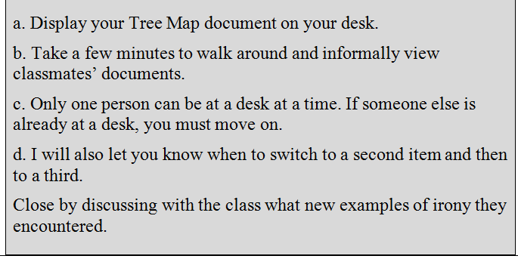
Gallery Walk: Tree Maps

Slide 38
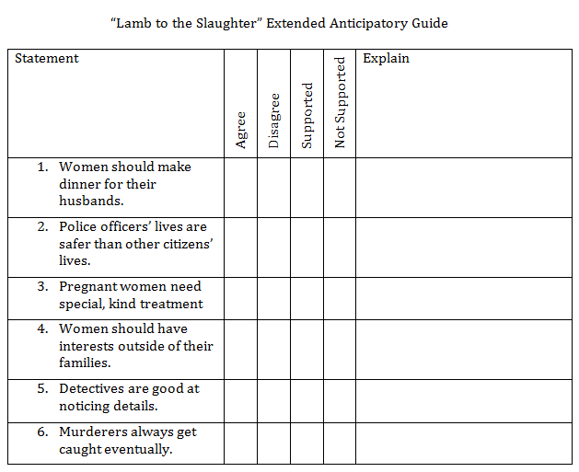
Revisiting the Extended Anticipatory Guide (Resource 1.4)
Decide whether each statement is supported or not supported in the text and place a checkmark in the appropriate column.
Explain your answers in the space on the right.

Slide 39
Option 1: Flee Map – Tracing the Language
At pivotal moments of the story, authors carefully use language to portray the emotions and the changing emotions of the characters at these moments. Trace the emotions of Mary and Patrick throughout the text and what language the author uses to convey these emotions. Look at not only actions but dialogue as well. With your partner, create a flow chart that analyzes their emotions with textual evidence from the story.

Slide 40
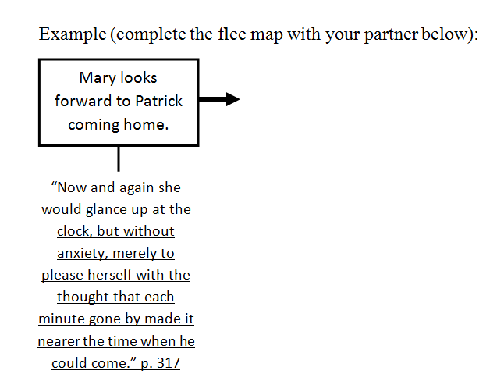
Flee Map (Resource 1.7)

Slide 41
Option 2: Movie Review (Resource 1.8)
Watch the Alfred Hitchcock version of Lamb to Slaughter on SchoolTube at the following link: http://www.schooltube.com/video/b4ffb2ed2146057eda1d/
Write a short essay or movie review focusing on how Hitchcock portrays the characters of Mary and her husband. Was this portrayal similar to the way you perceived the characters as you read the story? How was the portrayal similar or different to your view? Did viewing the visual text change your interpretation of the story? Explain why or why not.

