Slide 1
Types of Irony
Dramatic
Irony
Situational
Irony
Verbal
Irony

Slide 2
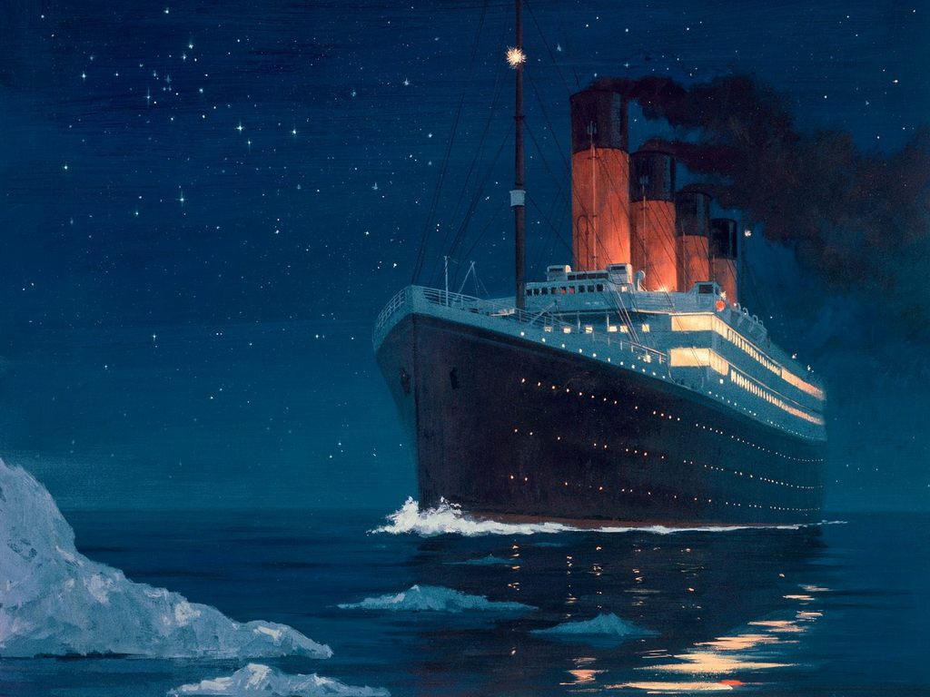
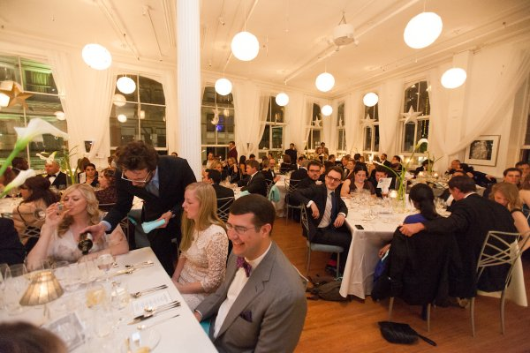
Dramatic
Irony
Definition: In a story when the audience knows something the character does not know.
Example: In the story of the Titanic, when the ship hits the iceberg, the audience knows it is serious danger, however, the passengers do not know.

Slide 3
Situational
Irony
Definition: When what happens in the story is opposite of what the reader expects to happen
Example: An English teacher who does not know how to spell
WELKUM TOO CLAS!!!

Slide 4
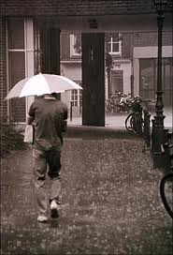
Verbal
Irony
Definition: When a speaker says one thing but means another.
Example: Dad looks outside at the pouring rain and says, “Nice day for a trip to the beach!”
“A perfect day for the beach!”

