Slide 1
Common Text Structures and Features
ELA Grade 6: Resource

Slide 2
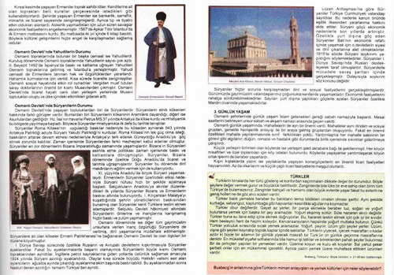
Text Features

Slide 3
External Text Features

Slide 4
Informational (Expository) Writing Assignments and the Structures Used

Slide 5
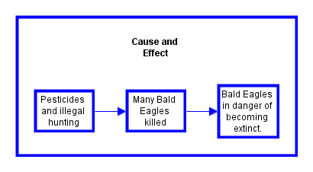
Text Structure: Cause and Effect

Slide 6
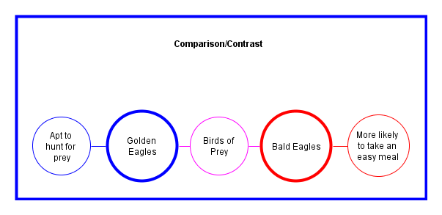
Text Structure: Comparison/Contrast

Slide 7
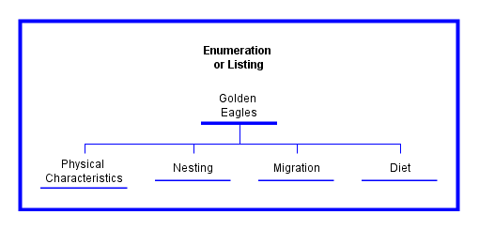
Text Structure: Enumeration or Listing

Slide 8
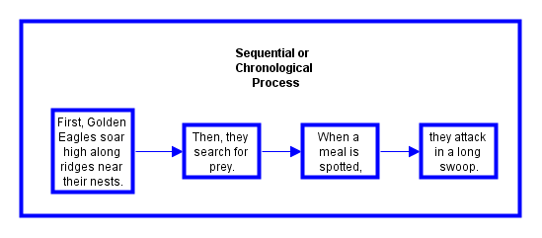
Text Structure: Sequential or Chronological Process

Slide 9
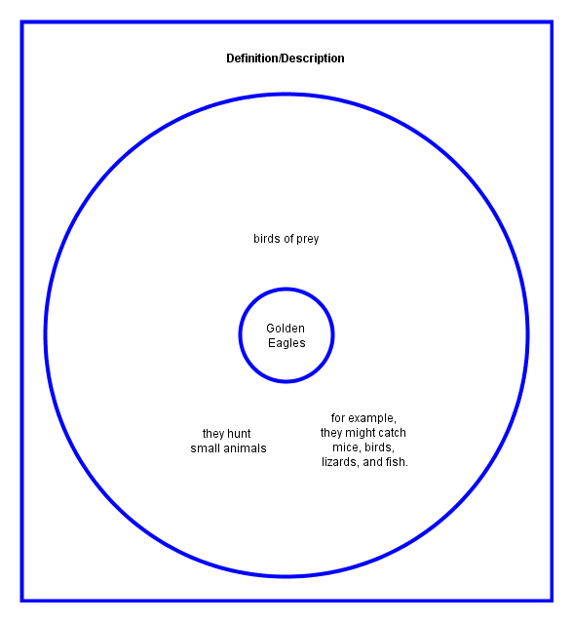
Text Structure: Definition/Description

Slide 10
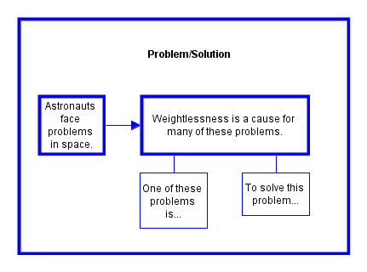
Text Structure: Problem/Solution

Slide 11
Let’s practice!
Read the following text and look for signal words/phrases to help you decide which type of text structure it is:
Signs of persuasive techniques include
a clearly stated opinion or claim
logical reasons for the opinion supported by relevant evidence
an appeal to the interests and backgrounds of a particular audience

Slide 12
What text structure did you guess?
Answer: Enumeration or Listing
Why?
Because the writer presents the information in a structure that resembles an outline using a bulleted format.

Slide 13
Let’s try one more…
Persuasive techniques convince an audience by providing sound reasons. These reasons persuade through strong, relevant supporting evidence. Propaganda techniques, though, appeal primarily to an audience’s emotions and may contain false or misleading information.
What type of text structure is this?

Slide 14
The answer is…
Comparison/Contrast
How do you know?
The writer explains how two things are different using the word “though.”
Persuasive techniques convince an audience by providing sound reasons. These reasons persuade through strong, relevant supporting evidence. Propaganda techniques, though, appeal primarily to an audience’s emotions and may contain false or misleading information.

Slide 15
Now you’re ready to tackle any texts!

