Slide 1
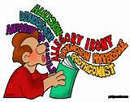
A Writer’s Style
Is defined by using Figurative Language and Literary Devices

Slide 2
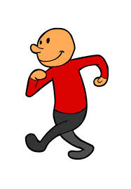
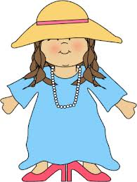
What is Style?
The way you walk
The way your friend dresses
A person’s style is created by how he/she does something.

Slide 3
To determine a writer’s style, look at the way he/she uses language.
Realistic dialogue
Lighthearted tone
Short, conversational sentences
Comical, main characters
Every writer has a style. Some styles are easier to recognize than others.

Slide 4
A writer’s style comes from the choices he/she makes when putting words on a page.
Long word vs. short word?
Simple sentence or complex sentence?

Slide 5
Figurative Language: Language used as part of a writer’s style Example: She was a beautiful flower.

Slide 6
Common figures of speech writers use:
Metaphor-comparing two unlike things without using a specific word of comparison
Simile-comparing two unlike things using a word of comparison (like, as, or than)
Personification-giving human or lifelike qualities to non-human things.
Idiom-using an expression that means something different from the literal meaning of the words.

Slide 7
Similes
Compare two unlike objects using words of comparison, such as like, as, or than.
Example: Jose was brave as a lion.
(Jose is being compared to a lion).

Slide 8
Metaphors
Compare two unlike things directly, without using words of comparison.
Example: Brittany is a delicate rose.
(Brittany is being compared to a rose).

Slide 9
Personification
Gives human or life like qualities or characteristics to non-human things.
Example: The leaves raced to the ground.

Slide 10
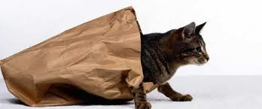
Idioms
Expressions that mean something different from the literal meaning of the words.
Example: He let the cat out of the bag.
(To tell secret information).

Slide 11
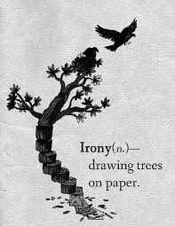
Literary Devices
To determine a writer’s style, look at his/her use of literary devices. Authors use this technique to produce a certain effect.
Examples of literary devices include:
imagery, irony, symbolism, and dialect

Slide 12
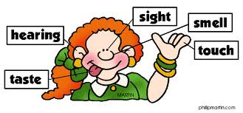
Literary Devices: Imagery
Language used by writers that creates word pictures and images by using sensory words that appeal to our senses (seeing, hearing, touching, tasking, and smelling).

Slide 13
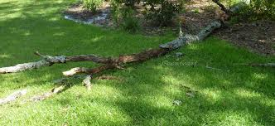
Imagery
Helps create pictures in your mind as you read.
“He fell down like an old tree falling down in a storm.”

Slide 14
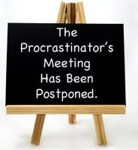
Irony
The use of words that mean the opposite of what you really think. There are three types of irony:
Verbal irony
Situational irony
Dramatic irony

Slide 15
Verbal Irony
This type of irony occurs when we say one thing but mean another (sarcasm).
Example: “My favorite thing is homework!”
(True meaning: I don’t like homework at all)

Slide 16
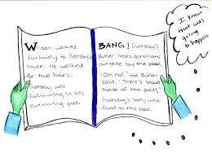
Dramatic Irony
This is the contrast between what the character thinks to be true and what the reader knows to be true.

Slide 17
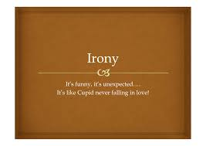
Situational Irony
It is the contrast (the opposite) between what happens and what was expected.

Slide 18
Literary Devices: Symbolism
A character, an action, a setting, or an object representing something else is a symbol.
Example: A dove symbolizes (stands for) peace.

Slide 19
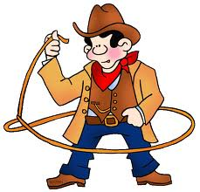
Literary Devices: Dialect
A way of speaking, which is characteristic of a certain place or group of people is dialect.
Example: “Howdy, y’all”
Writers use dialect to give clues about the characters and settings in stories in order to bring them to life.

