Slide 1
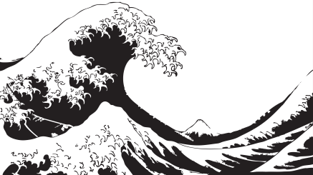
The Big Wave
Lesson 1

Slide 2
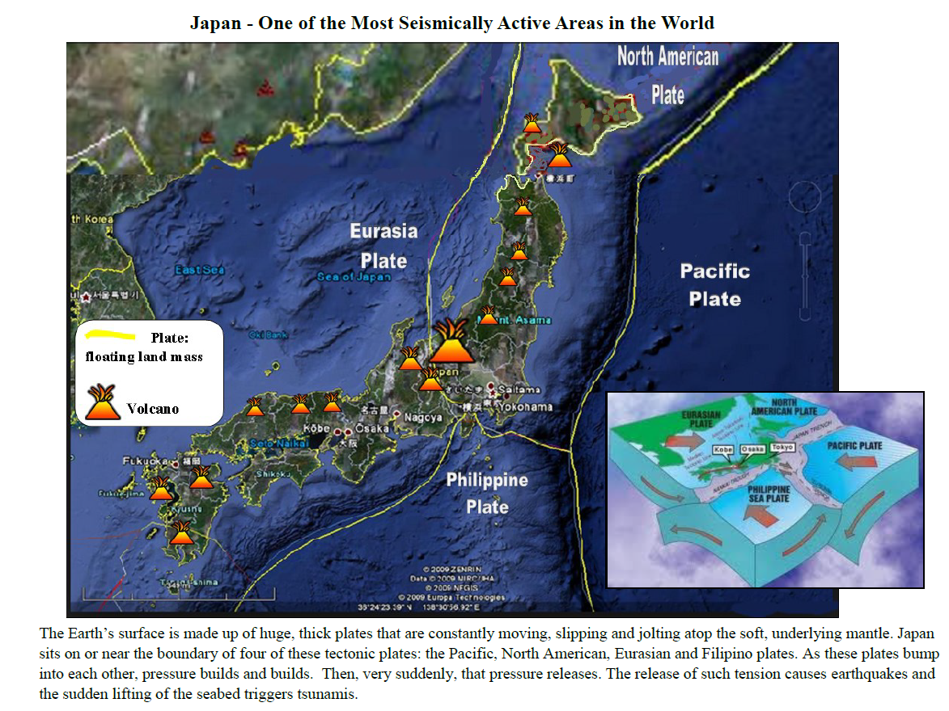

Slide 3
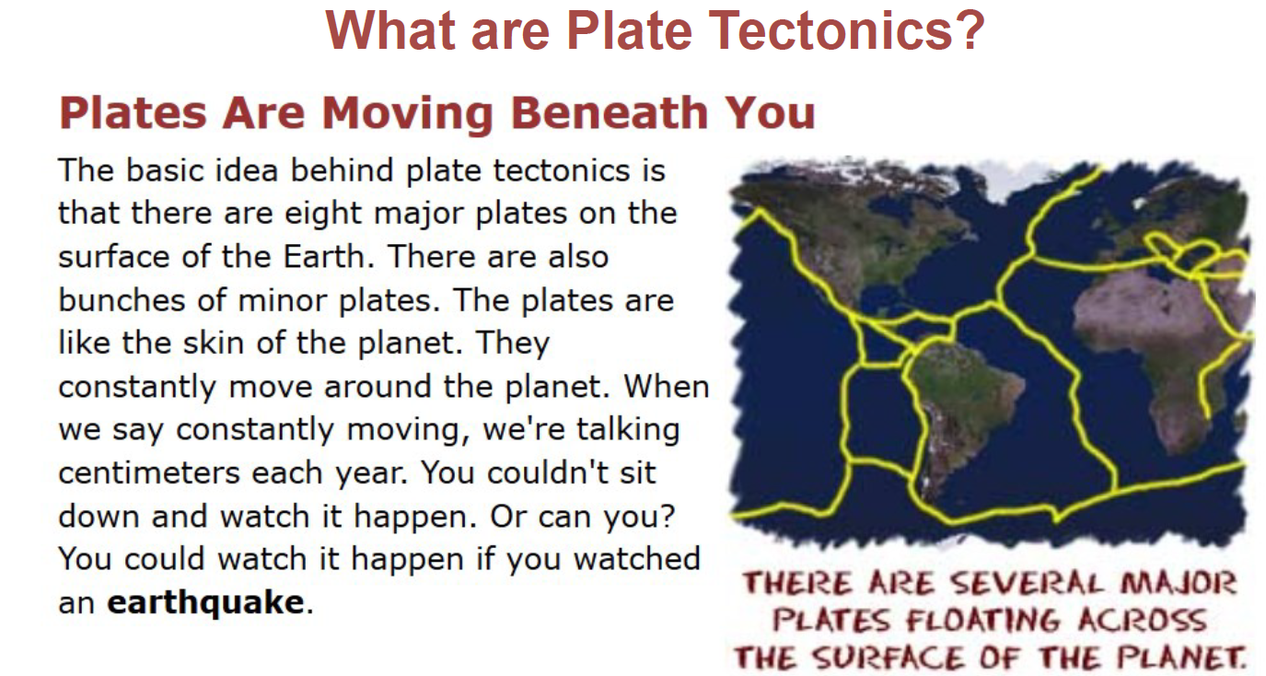

Slide 4
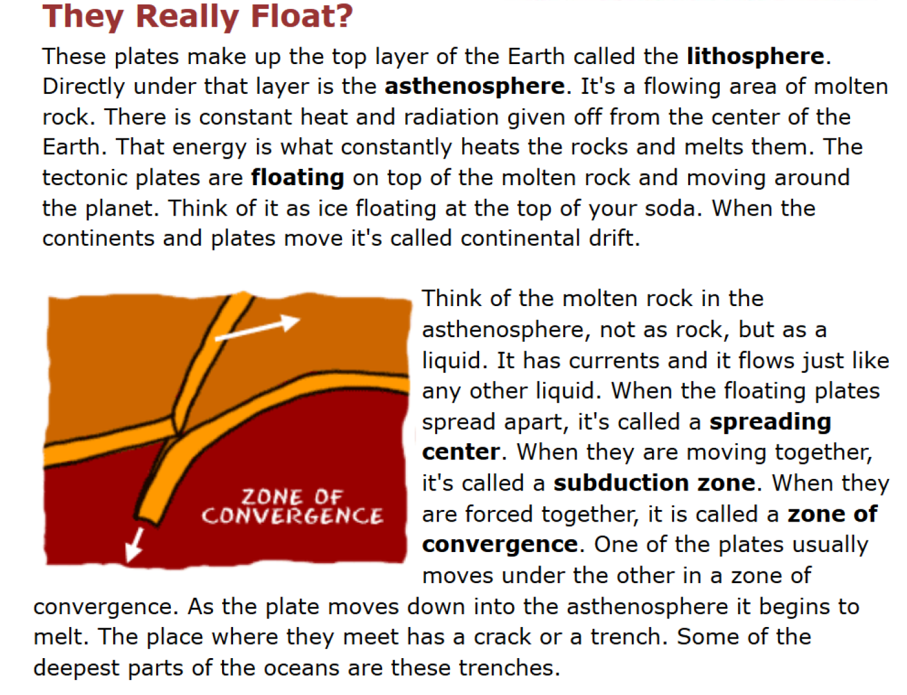

Slide 5
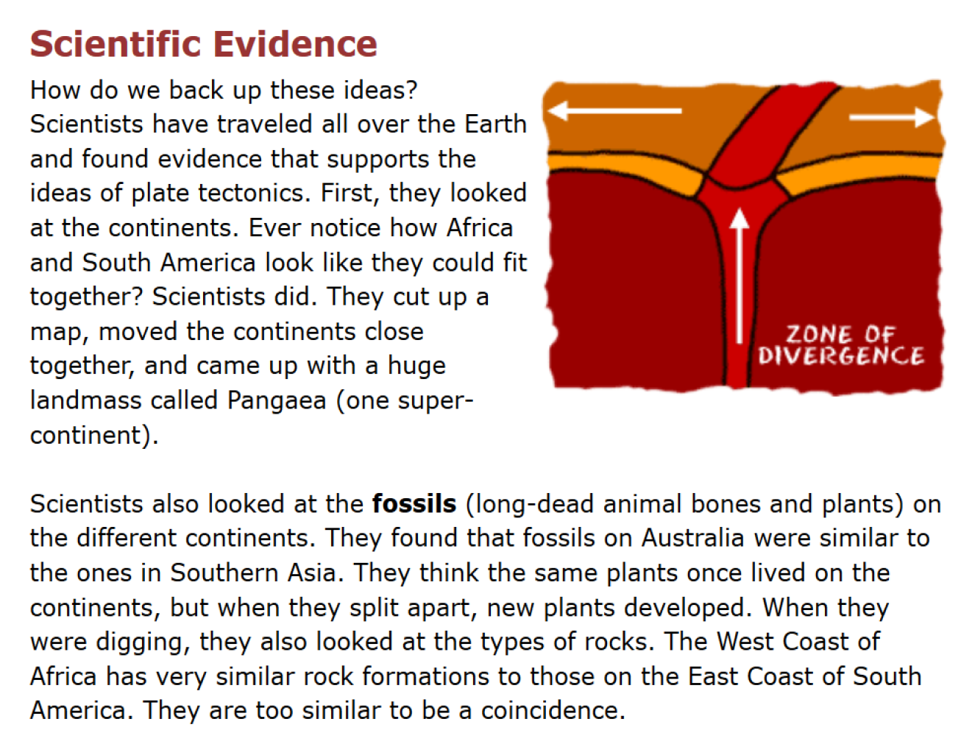

Slide 6
Photo Gallery
Northern Shore of Japan

Slide 7
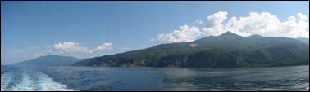
Northern Japanese Coast

Slide 8
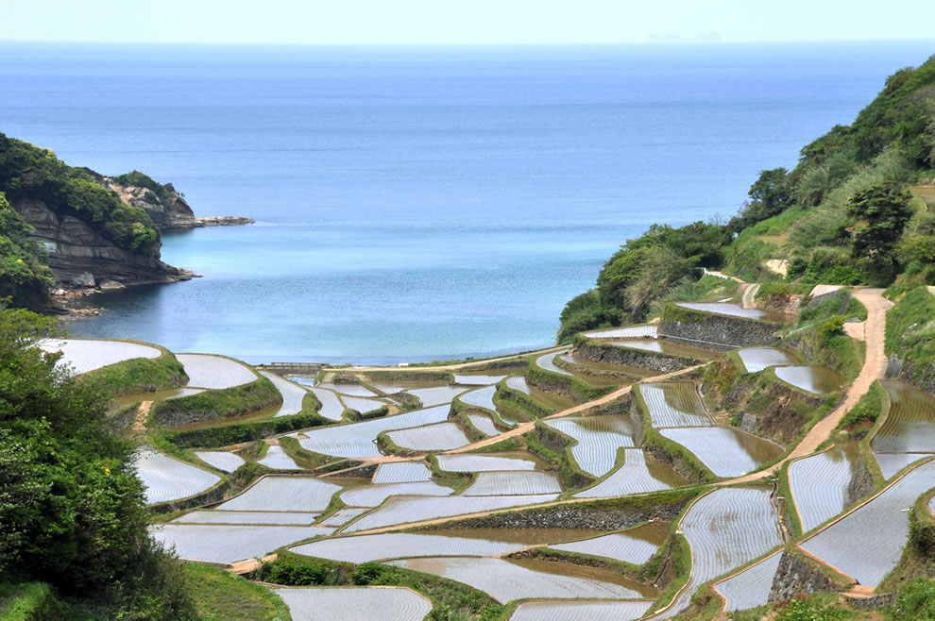

Slide 9
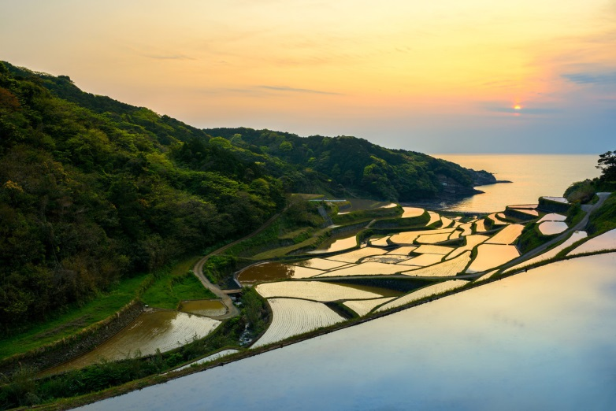

Slide 10
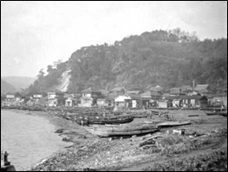

Slide 11
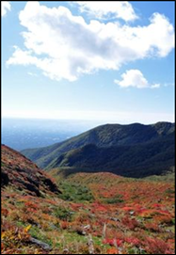

Slide 12
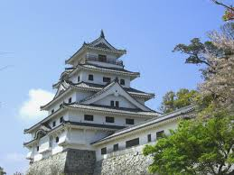

Slide 13
Artists Interpretations of Setting
Northern Shore of Japan

Slide 14
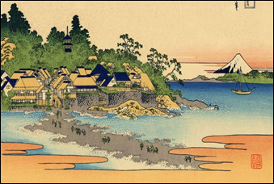

Slide 15
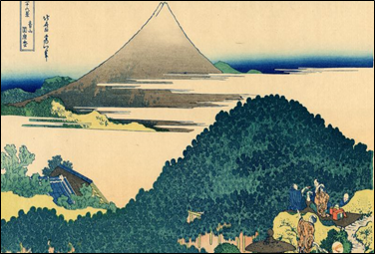

Slide 16
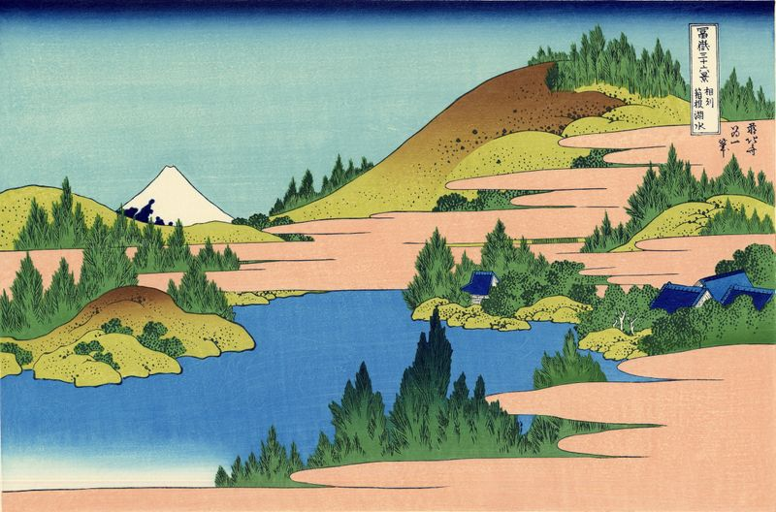

Slide 17
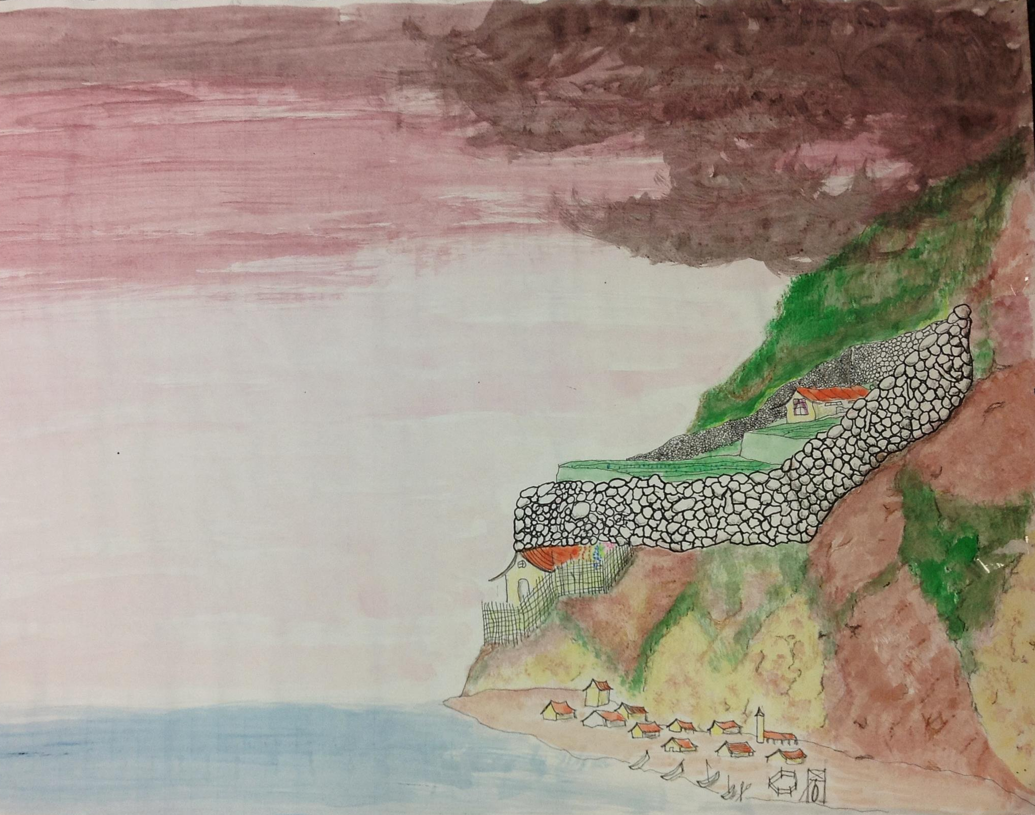
Setting of The Big Wave

Slide 18
Narrative Arc
Plot of Story

Slide 19
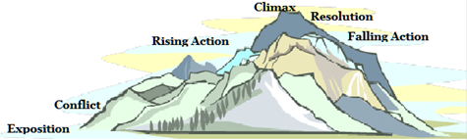
Narrative Arc
The plot is what happens in the story. Each scene happens in a certain order to keep readers interested and entertained. That order, with its rising, cresting, and dropping levels of excitement, is called the narrative arc. In other words the “narrative arc” is a fancy way of saying that every story needs to have a beginning, middle, and end.

Slide 20
Narrative Arc
A good story starts by introducing the characters, their setting, and a problem. That introduction is called the exposition, because the author is exposing the situation to us.

Slide 21
Narrative Arc
The problem itself is called the conflict. A story would be very boring without conflict! Who cares about a story in which nobody disagrees or needs anything, and nothing goes wrong?

Slide 22
Narrative Arc
Then the action gets more and more exciting; that’s called the rising action. You can see on the illustration that the action rises up until it reaches the peak.

Slide 23
Narrative Arc
The top, or climax, is when the problem has gotten so bad it just has to be solved.

Slide 24
Narrative Arc
The way it’s resolved, or fixed, is called the resolution.

Slide 25
Narrative Arc
After the resolution, the action gets less and less exciting; that’s called the falling action. You can see on the illustration that the slope falls down for a little bit, and then the action stops. The story ends..

Slide 26
Primary Sources
People of Japan

Slide 27
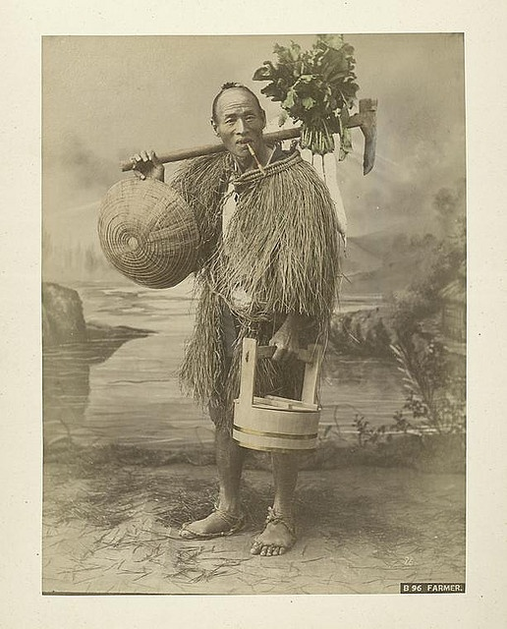
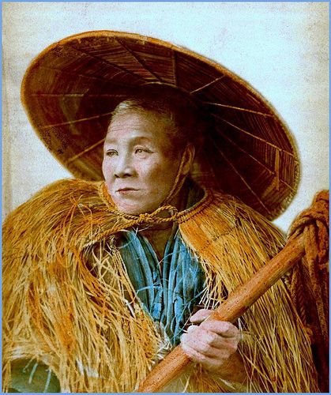
Japanese Farmers

Slide 28
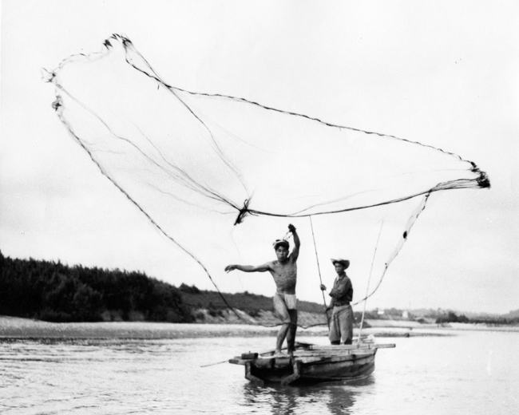
Japanese Fishermen

Slide 29
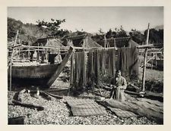
Fisherman nets, 1800’s

Slide 30
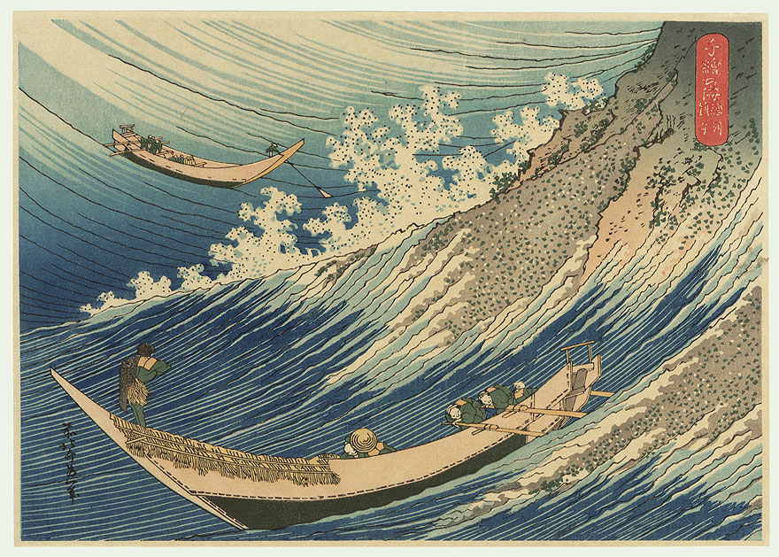
Illustration – Japanese Fishermen

Slide 31
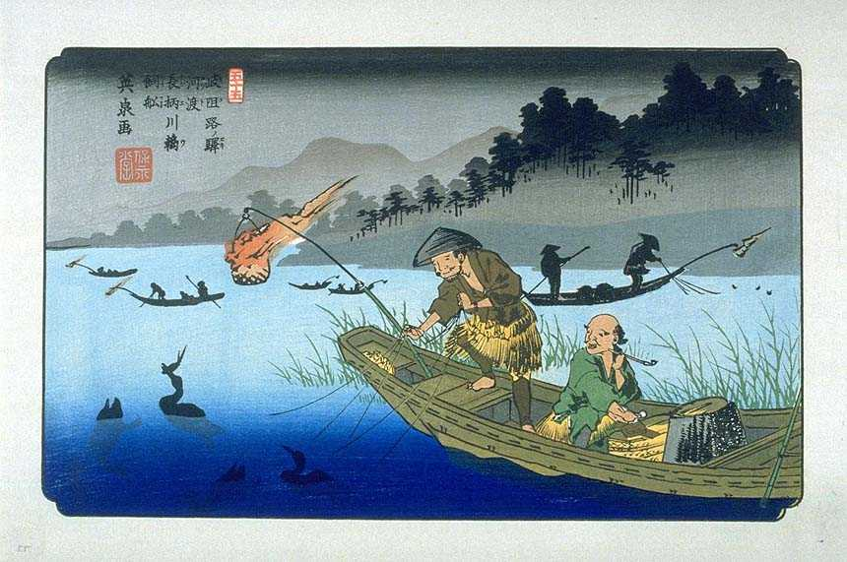
Fisherman

Slide 32
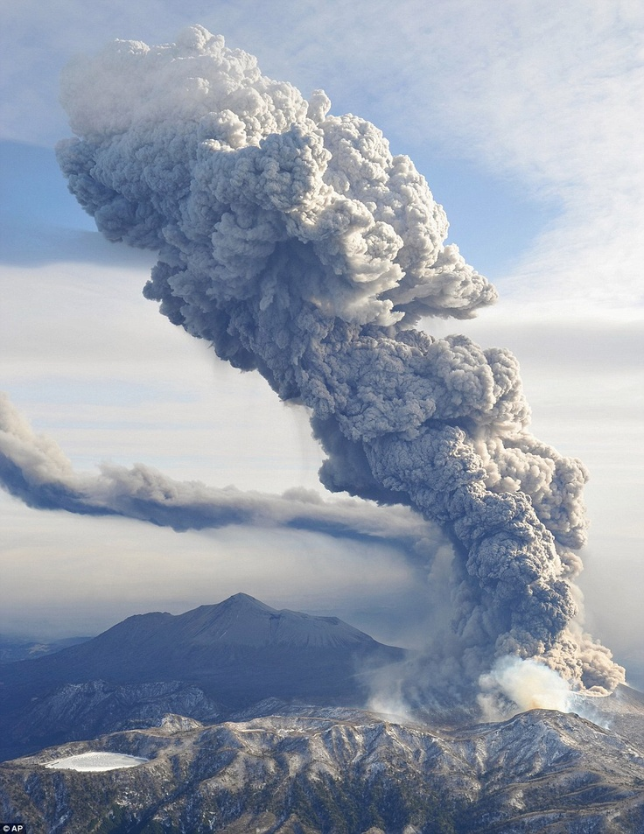
Volcano Warning

Slide 33
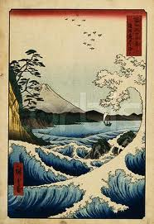
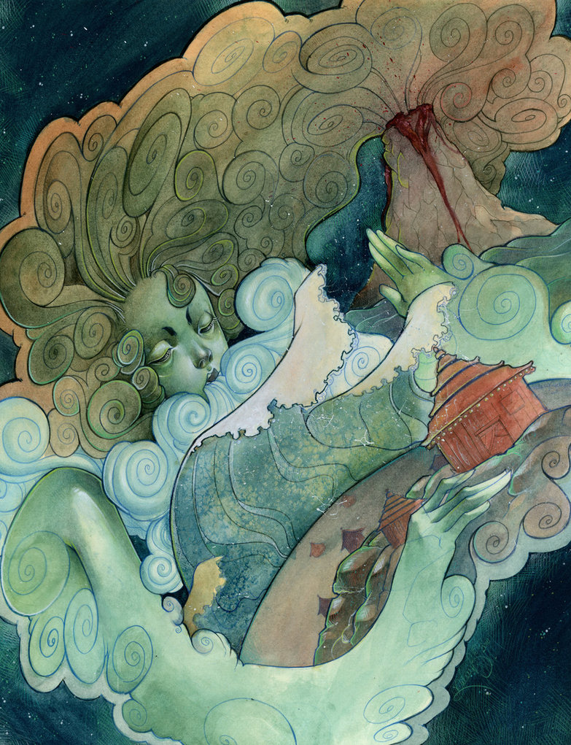
Interpretations of the “Big Wave”

Slide 34
Art Lesson

Slide 35
Inspiration from the book
Kino lived on a farm. The farm lay on the side of a mountain in Japan. The fields were terraced by walls of stone, each one of them like a broad step up the mountain. Centuries ago Kino’s ancestors had built the stone walls that held up the fields.
Above all the fields stood the farmhouse that was Kino’s home. […] he was glad that he lived so high up because he could look down on the broad blue
ocean at the foot of the mountain.

Slide 36
Art Lesson

Slide 37
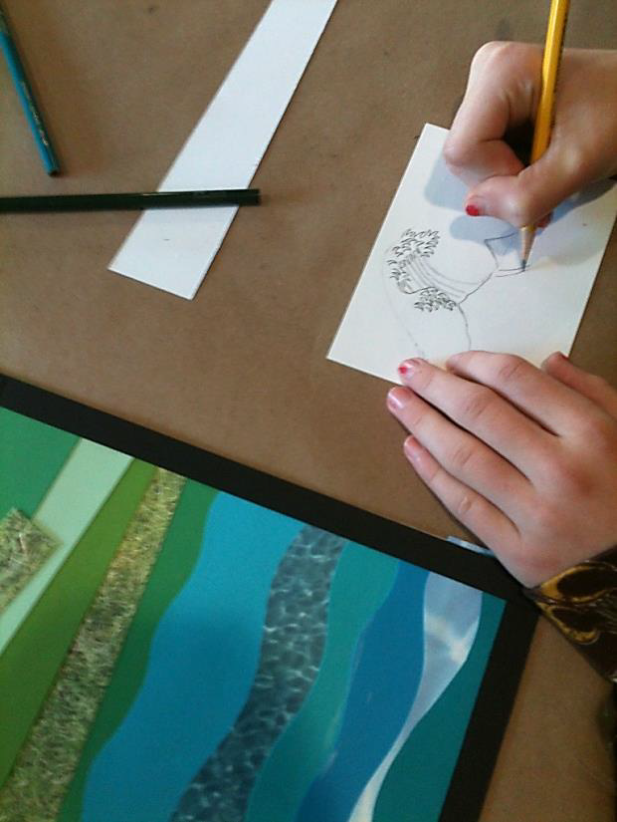
Draw the wave

Slide 38
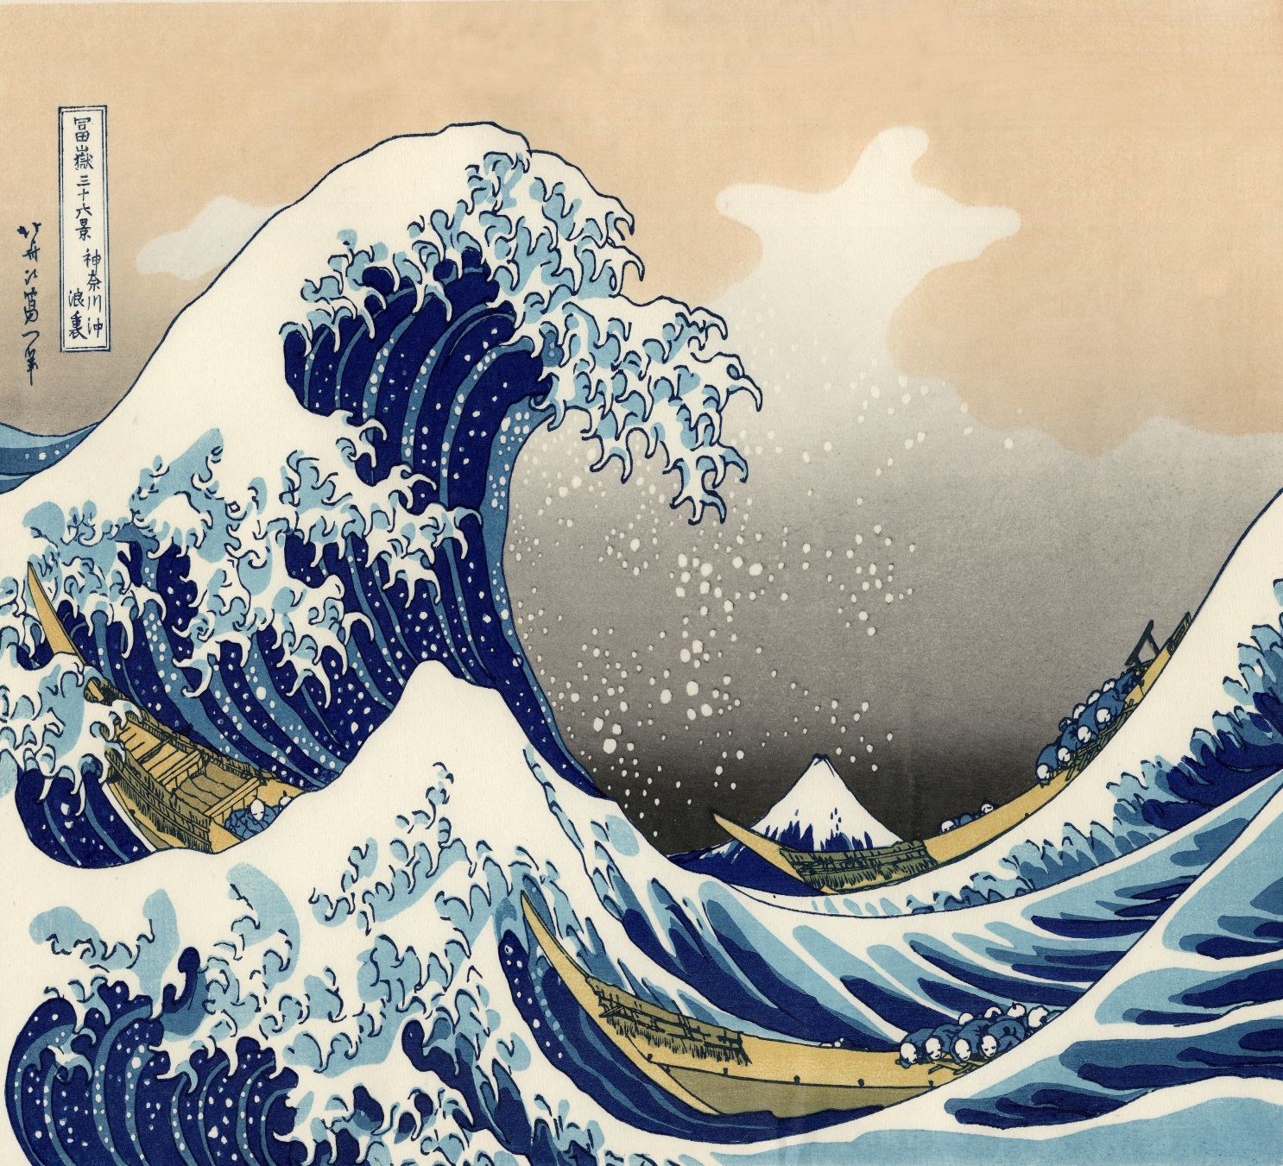
For window in art lesson

