Slide 1
Lathrop Intermediate School
Hispanic Heritage
College Prep
Friday, September 18, 2015
Be Respectful
Be Responsible
Be Safe

Slide 2
Hispanic Heritage Month
The observation started in 1968 as Hispanic Heritage Week under President Lyndon Johnson and was expanded by President Ronald Reagan in 1988 to cover a 30-day period starting on September 15 and ending on October 15.
It was enacted into law on August 17, 1988, on the approval of Public Law 100-402
Be Respectful
Be Responsible
Be Safe

Slide 3
Hispanic Heritage Month
Why Sept. 15?
It's recognized as the independence day of five Latin American countries: Costa Rica, El Salvador, Guatemala, Honduras and Nicaragua.
Mexico celebrates its anniversary of independence on Sept. 16, and Chile on Sept. 18.

Slide 4
Lathrop Intermediate School
America's diversity has always been a great strength of our nation.
Today, according to the U.S. Census Bureau, more than 54 million people in the United States are of Hispanic origin. That's about 17 percent of the total US population!
Be Respectful
Be Responsible
Be Safe

Slide 5
Lathrop Intermediate School
64% The percentage of Hispanic-origin people in households who are of Mexican background. Another 9.4% are of Puerto Rican background, 3.8 percent Salvadoran, 3.7 percent Cuban, 3.1 percent Dominican and 2.3 percent Guatemalan. The remainder are of some other Central American, South American or other Hispanic/Latino origin.
Be Respectful
Be Responsible
Be Safe

Slide 6
Lathrop Intermediate School
Hispanic Americans have contributed to many areas of American life including science, art, entertainment, literature, sports and government.
Be Respectful
Be Responsible
Be Safe

Slide 7
Hispanic Heritage Month
As we celebrate National Hispanic Heritage Month, we recognize and applaud the extraordinary accomplishments of Hispanic Americans.
Be Respectful
Be Responsible
Be Safe

Slide 9
Carlos Santana
Carlos Santana is a Grammy-Award winning musician. He is Mexican American.

Slide 10
Jennifer Lopez
Jennifer López is a famous singer and actress. In addition, she has been successful as a designer and producer.
Her parents are Puerto Rican.

Slide 11
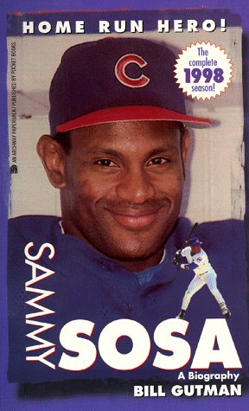
Sammy Sosa
Sammy Sosa Peralta is a famous baseball player. Throughout his career he played on these teams: Texas Rangers, Chicago White Sox, Chicago Cubs and Baltimore Orioles. Birthplace: Dominican Republic

Slide 12
Salma Hayek
Salma Hayek is a famous actress, both in Mexico and the U.S. She has also been successful as a director, producer and singer. Birthplace: Mexico

Slide 13
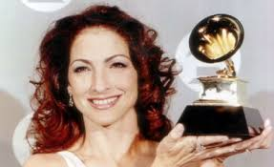
Gloria Estefan
Gloria Estefan is most famous for being a singer and songwriter. In addition, she is an actress, children’s book writer, and the owner of multiple restaurants and hotels. She is a Cuban-American.

Slide 14
Ellen Ochoa
Ellen Ochoa is a Mexican-American astronaut. She was the first Mexican-American woman in space and is known for her contributions to NASA.

Slide 15
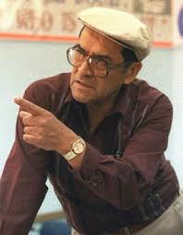
Jaime Escalante
Jaime Escalante was a math teacher in East Los Angeles from the 1970’s to the 1990’s.
He gained recognition in the early 1980’s when he challenged his high school students– to pass the challenging Advanced Placement Calculus exam and receive college credits.
Mr. Escalante’s accomplishments were the subject of the 1988 movie Stand and Deliver, and the book of the same year, Escalante: The Best Teacher in America. He was considered one of the most famous educators in America.
Be Respectful
Be Responsible
Be Safe

Slide 16
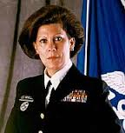
Antonia Coello Novello
U.S. Surgeon General: Antonia Coello Novello, 1990–1993. She was also the first woman ever to hold the position. Birthplace: Fajardo, Puerto Rico

Slide 17
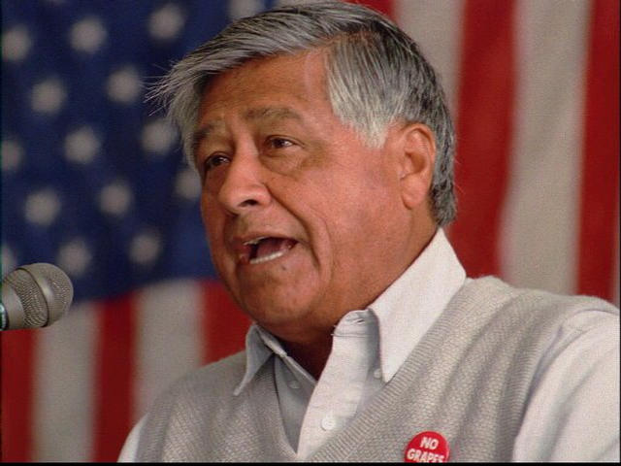
César Chávez
César Chávez was a human rights activist and a labor union leader who fought tirelessly for the rights of workers. He co-founded the National Farm Workers Association. He died in 1993.
Be Respectful
Be Responsible
Be Safe

Slide 18
Hispanic Heritage Month
What is celebrated during Hispanic Heritage Month?
Name one famous Hispanic American woman and the reason she is famous.
Name one famous Hispanic American man and the reason he is famous.
Be Respectful
Be Responsible
Be Safe

Slide 19
Learning Center
Starting next Tuesday, September 22, 2015 the Learning Center will be open for students
8:00 – 2:45 Mondays
8:00 – 4:30 on T-W-Th-F
For students whose parents have opted to Daily Check of a Chromebook
Check out time: 8:00 – 8:10 am M-T-W-Th-F
Check in time:
2:28 p.m. – 2:45 p.m. on Mondays
2:30 p.m. – 4:15 p.m. on T-Th-F
1:22 p.m. – 4:15 p.m. on W

Slide 20
Learning Center
Operation Hours
8:00 – 2:45 Mondays
8:00 – 4:30 T-W-Th-F
Access to Wi-Fi
Educational purposes
Quiet learning environment
Lost & Found
If you lost a book or a Chromebook, please turn it in to Ms. Cook in the Learning Center

