Slide 1
Leslie Valladarez
Forensic Psychologist and Ultrasound Technician
January 13,2011
Mrs. Van Dusen
AVID/Per.6

Slide 2



Why these careers?
Forensic Psychology: I always was interested in forensics and also on the way people thoughts worked. So when I heard there was a profession with both, I knew it was made for me. :)
Ultrasound Technician: I love little kids and epically babies so helping a mother deliver one seems fun.

Slide 3


What are the specific job duties for these careers?
Forensic Psychology: They’re involved in custody disputes, child custody evaluations, and investigate reports of child abuse.
Ultrasound Technician: help mothers by checking on the child while in the wound for any problems.

Slide 4
Do you need “people skills” to be successful at the career? What kind of skills are needed?
Forensic Psychology- you need:
    People skills
    Patience
    Creativity
    Commitment
Ultrasound Technician- you need:
    People skills
    Responsibility
    Commitment

Slide 5

What ARE The working conditions?
In Forensic psychology you work in courtrooms and have long hours, unless you have your own business
In Ultra Sound Technician you work in hospitals, diagnostic centers and physician offices.

Slide 6
What training is required, how much education,
A forensic psychologist needs 5-7 years of college, and get a degree in forensic psychology or a psychology degree
A Ultrasound Technician needs basic certification, associate degree or a bachelor’s degree

Slide 7

What fees are required for this career?
Both have college fees

Slide 8
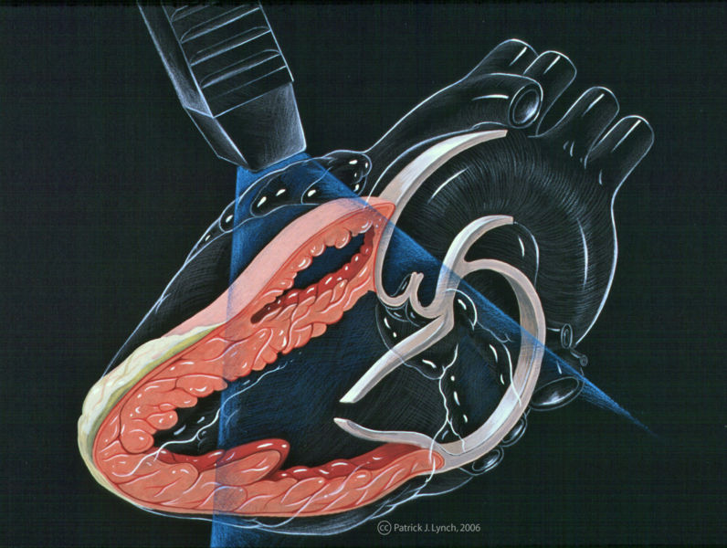
What different kinds of jobs could you have in these careers?
In forensic psychology you can also become a psychologist, or a private/certified forensic psychologist.
In ultrasound technician you can be a gynecologic sonographer, abdominal sonographer, ophthalmic sonographer and echocardiography

Slide 9


What is the future outlook for this career?
For forensic psychology the outlook is good and in the last 20 years it has been growing
In ultrasound tech its in high demand and expected to rise 19% from now to 2016

Slide 10
How much could you earn in the careers?
For forensic psychology you can ear between $35,000-$40,00 and private earn more
Ultrasound Technician begin with $40,000, on average they earn 60,00 and Veterans earn 80,000

Slide 11

What are the perks and drawbacks?
Some perks of forensic psychology is you have subfield options
Some drawbacks are that it’s a stressful job, don’t get paid much and exhausting
In Ultrasound Technician you get healthcare, pension 401K
Some drawbacks are some states don’t have high demand

Slide 12
Compare and contrast careers
Contrast
Contrast
Compare
In medical
In law
Long
Hours
Can be done 2 years or more
Takes 5-7 years

Slide 13
Would I still purse the careers? What have I learned?
I would still purse a career in forensic psychology:)
i learned that there is a lot of school I have to take and training, but I’m willing to go threw it
I would not work as a Ultrasound Technician, only if my forensic psychology career didn’t go well.
I learned its not as interesting as I thought It was and probably wouldn’t go threw with it.

Slide 14
Bibliography
Psychology.about.com
www.criminal-justice-careers.com
http://www.psychologyinfo.com/forensic/
www.ultrasoundlearning.com/
http://www.ultrasoundtechnicians.com/

