Slide 1
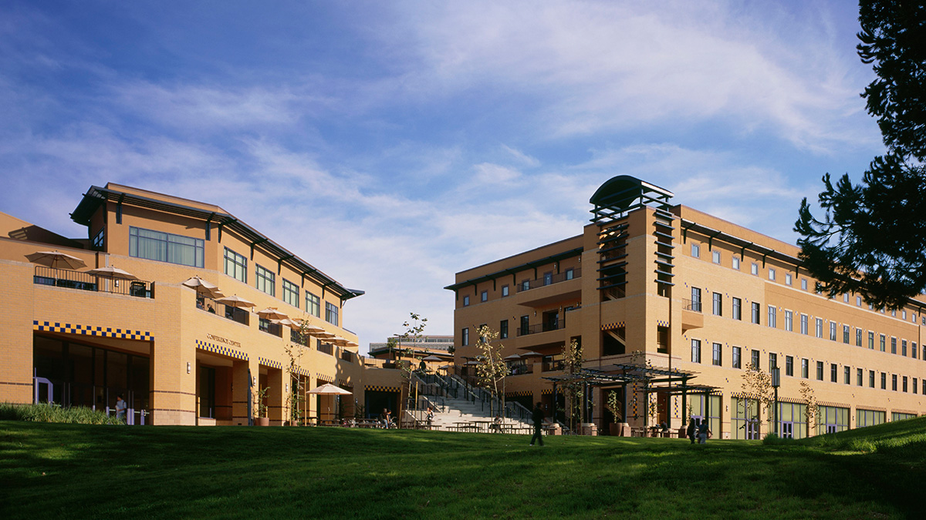
University of California, Irvine (UCI)
Location: Irvine, CA 92697
Brando Urquiza
Period 1
Mascot: Peter the Anteater

Slide 2
First and second choice for majors
My first choice for a major, is a medical major, since I want to be an allergist.
My second major, is architect design, since I want to become an architect.

Slide 3
Why did I pick UCI?
I picked UCI because it is the closest university from where I live. Also, I picked UCI because I wouldn’t have to waste money living in a house, since I could live in my parent’s house. UCI is focused on the medical field, which is what I want a degree on.

Slide 4
What are the admissions requirements for UCI?
You must receive a 3.0 GPA or higher in the required A-G subjects, during 10th and 11th grade.
Receive a overall minimum of a 3.4 GPA in order to be eligible for the UC system
you will have to complete your required A-G courses
Excellent standardized test scores/exams, such as your SAT and ACT test scores

Slide 5
What is the application process?
The application date for the UCs opens in August 1
An online application must be submitted, along with a 70$ nonrefundable application for in-state applicants, or 80$ for international applicants

Slide 6
What is probation?
Probation is when students are placed on an academic restriction for what classes they could take, if they have a 2.0 GPA, or lower
Probation means that you are not eligible to take a letter graded class, meaning that you can only take pass/fail classes

Slide 7
Acceptance rates
88,792 students from in and out of state applied to UCI
Out of these applicants, 18474 are in-state freshman Latinos, the largest number among the nine university of California’s (UC) campuses
There was a 35.4 acceptance rate in UCI
All this information was recorded in 2014

Slide 8
Degree requirements
a bachelor's degree and successful completion of medical school, which involve four years of undergraduate study and four years of medical school
Completion of at least one year of biology, physics and English, and two years of organic chemistry as part of their undergraduate education.
A medical degree is majored in UCI

Slide 9
Specific math requirements
Three years (four years recommended) of college-preparatory mathematics
Required classes are algebra, geometry, and advanced algebra
You must have a letter grade of C or better in any transferable mathematics course, in order for it to become valid

Slide 10
Pass/fail classes available at UCI
Medical schools (also in UCI) will not accept P/F grades for pre-required courses. Any course that you plan to use to fulfill requirements for admission must have a grade.

Slide 11
Classes available in line at UCI
Business and management: Business Administration, Contact Management, Legal Risk Management, Meeting & Event Management, Sports Management, and Supply Chain Management
Educational classes, such as a virtual teaching class
Business classes
Clinical research and trial classes
Engineering tech: Communication System Engineering, Device Software Engineering, Digital Signaling Processing, and Embedded System Engineering.

Slide 12
What is the difference between a BA and a BS?
Bachelor of the Arts, and the B.S., or Bachelor of Science, are four-year undergraduate degrees. The primary difference between the two types of degrees is the focus of the coursework students are required to complete in order to earn them.
A Bachelor of the Arts degree program provides students with a more expansive education, requiring fewer credits that are directly linked to a particular major
Bachelor of Science degree are generally more strictly focused on their subject matter, requiring more credits that are directly linked to the major

Slide 13
Does my major allow for a BA of BS or what ?
A medical degree allows both a BA degree and a BS degree
It is known that an BA is easier to obtain than a BS in the medical field
It depends on what you want to do in the medical field that is more suitable for a BA/BA degree.

Slide 14
What GPA do I need in order to graduate for my major?
An GPA score that is close to 3.4 would be required for a medical degree
It isn’t just the GPA that determines if you graduate for a medical degree. The classes you take, activities, and test scores are the things that are looked at for graduation.

Slide 15
Where can I receive help (tutoring) on campus?
I can receive tutoring in UCI’s Learning and Academic Resource Center, which is dedicated to their student’s needs of tutoring

Slide 16
What and where is academic advising?
Academic Advising is an opportunity to exchange information designed to help students reach their educational and career goals
Academic advising is provided both within the Division of Undergraduate Education and in Academic Schools around campus

Slide 17
Required courses and electives I plan to take
Biology
English
Math
Physics
Social science
Chemistry
Biochemistry
Anatomy
Phycology
Microbiology
Pathology
Medical ethics
nursing

Slide 18
Are there any classes not offered or under special perquisites?
Since UCI is specialized in medicine, they have all the classes that I will need to take for my medical degree.

Slide 19
What I will do with my degree
With my medical degree, I will complete the rest of my required education, in order to become an allergist. After I get my degree, I will do special training and internships for my requirements of a future allergist position.

Slide 20
What is the average base salary and overall salary for someone in my profession?
An allergist will usually earn an overall annual salary between 144,000 through 216,000
A typical base salary for an allergist, would be between 39$ through 74$

Slide 21
What job placement opportunities does my university offer?
Since UCI has a medical school, I could go to their medical school. From there, I could perform medical and nursing placement opportunities.

Slide 22
What are university tuition rates and how much of my need will they meet?
UCI’s tuition fee is $11,220 for in-state students
UCI’s Reduced tuition fee is $5,610 for in-state students
Looking at both tuition fees, UCI will help with my needs by 50%!

Slide 23
What are other expenses?
The following expenses are in-state annual expenses
$12,073 (board and room)
1,583 (books and supplies)
1,929 (other fees)
These expenses are $15,585, which gathers up to 26,805 when the tuition fee is added ($11,220)

Slide 24
What is the difference between loans and grants?
Grants are money you don't have to repay and are usually based on your financial need while loans are money you borrow that you must pay back, usually with interest costs.

Slide 25
What is the difference between qualifying for loans and grants?
In order to qualify for a loan, you will have to apply and prove that you can pay back the cash, including the interests.
For Grants, people or companies will sponsor you when they see that you are normally getting excellent grades and always giving extraordinary effort. The requirement is basically to be a good student, and stay like that

Slide 26
Where can I find out about financial aid?
Visit the financial aid office at the college you plan to attend
Visit the Federal Student Aid YouTube page
Updates and information from the Federal Student Aid Facebook page and @FAFSA Twitter feed
Visit StudentAid.gov
Visit https://fafsa.ed.gov

Slide 27
Where and how often do I need to apply for financial aid?
I will have to apply for financial aid every academic year
Also, I will have to sign up to any other extra financial aid opportunities at any time they allow me to during each academic school year

Slide 28
Where do I plan to live?
I plan to live in my parents house since I live close to UCI.

Slide 29
What are my living expenses?
As I previously mention, I will be living with my parents house since it is close to UCI. Logically, my living expense will zero dollars through out all the academic years I attend UCI.

Slide 30
Who will I live with?
Since I am living in my parents house, I am logically going to live with my parents.

Slide 31
What jobs are available for me as a student?
Any job that isn’t required to work full-time would be an available job as a student
Any job that I am allowed to work in UCI’s campus
Internships that are required in order to become an allergist
Any job that offers flexible work hours.

Slide 32
Are these conditions for underclassmen to live on campus for a certain number of years?
The requirement for underclassmen to live on campus, is that you are allowed to live there as you attend UCI.

Slide 33
What social activities are offered?
100 Black College Women of UCI
A.B.C. (Anteater Book Club ABC)
Accounting Association
Acrobatics Everyday
Active Minds at UCI
Afghanistan Development Project
African Black Coalition
Welcome Picnics
International Potlucks
Beach Bonfire
Summer Pool Party
Halloween Festival
Soccer Tournaments
Field trips
Volunteering opportunities

Slide 34
What are the transferring rules to get in UCI?
60 semester or 90 quarter UC transferable units with a minimum 2.4 GPA
Complete the following seven transferable college courses (with a grade of a C or better in each course)
Two UC transferable courses in English composition
One UC transferable course in mathematical concepts and quantitative reasoning
Four UC transferable courses chosen from at least two of the following areas: the arts and humanities, the social and behavioral sciences, or the physical and biological sciences

Slide 35
What are the transferring rules to transfer to another university?
Transferring rules to transfer to another university, are passing letter grades in all your classes, excellent GPA, and satisfactory test scores. Also, you will have to make sure that your classes are transferable.

Slide 36
Do the courses that you are taking also fill the conditions of my second major?
My classes that I plan to take don’t fill my requirements/conditions of my second major, because I am focusing on a medical degree, meanwhile my second major is an architect major. These two majors are completely different, requiring different skills, classes, and involvement.

Slide 37
What is the procedure for changing majors?

Slide 38
What I learned from this project
I learned that UCI offers a variety of clubs, giving it’s campus a diversity of students. I also learned that UCI will help my tuition and other fees by 50% What I found surprising, is that UCI received the most Latino applicants out of all the UCs. UCI has an academic center that is dedicated to student’s tutoring needs.

Slide 39
Bibliography
http://uci.edu
https://www.admissions.uci.edu/applicants/key_dates.html
http://www.editor.uci.edu/11-12/intro/intro.16.htm
http://work.chron.com/qualifications-allergist-21485.html
http://admission.universityofcalifornia.edu/freshman/requirements/a-g-requirements/
http://unex.uci.edu/courses/
http://www.bestvalueschools.com/faq/what-is-the-difference-between-a-b-a-and-a-b-s/
http://classroom.synonym.com/better-ba-bs-medical-school-5388.html
http://www1.salary.com/Physician-Immunology-Allergy-Salary.html
http://www.healthcare-salaries.com/physicians/allergist-salary
https://www.reg.uci.edu/fees/2014-2015/graduate.html
http://www.collegesimply.com/colleges/california/university-of-california-irvine/price/
https://fafsa.ed.gov/help/fftoc05l.htm
https://www.admissions.uci.edu/applicants/transfer_admission.html
http://www.changeofmajor.uci.edu/CoM_principles.html

